Slide 1
WG2 Report: Local Engagement
Deborah Oughton
NERIS Platform GA
Madrid 21st May 2013

Slide 2
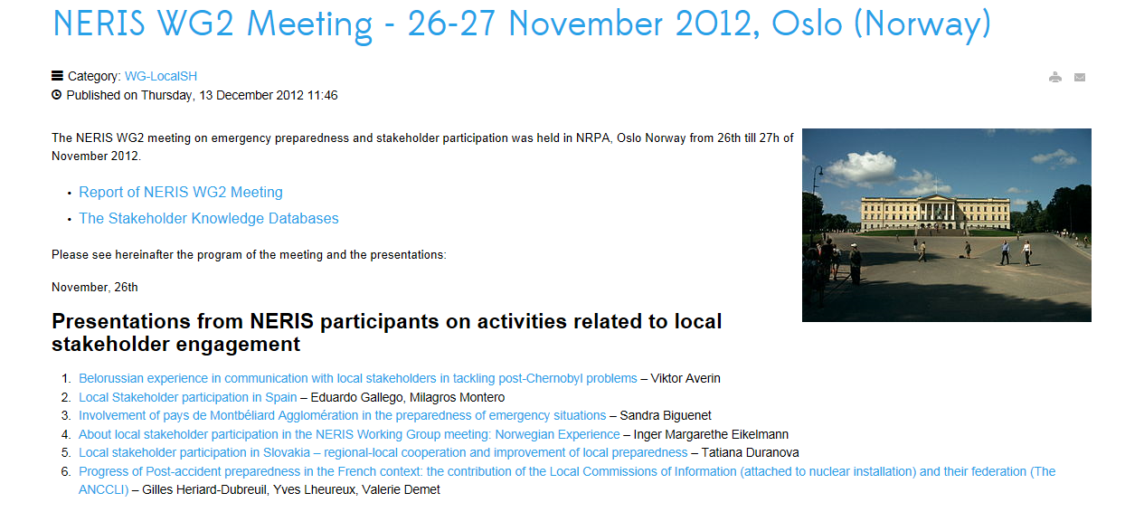
WG2 Workshop Oslo, November 2012
www.eu-neris.net
Notes:
EMERGENCY PREPARDENESS AND STAKEHOLDER PARTICIPATION

Slide 3
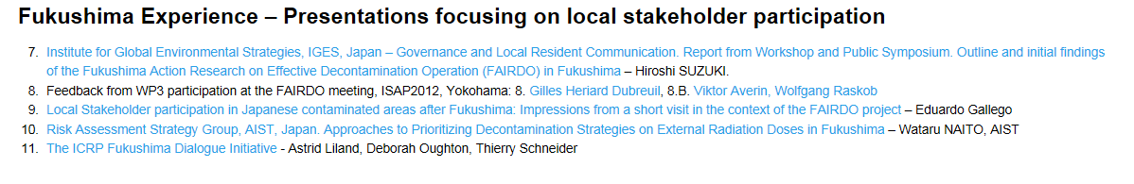
WG2 Workshop Oslo
29 participants (ca. half «external» to the NERIS-TP project)
Sessions on:
  European national stakeholder experience
  Fukushima experience – local stakeholder participation
  Database of stakeholder participation
Notes:
The meeting was attended by 29 participants and divided into three main sessions: the first on European national stakeholder processes, including presentations of experience from activities in Belarus, Spain, Norway, France and Slovakia; and the second on Fukushima experience, including presentations on the FAIRDO project, local stakeholder participation processes, ICRP co-expertise dialogues, and the effectiveness of decontamination processes. Both presentations and the following discussions highlighted the complexity of the situation, and that radiation issues were only one part of a much broader challenge. The final part of the meeting was dedicated to creating a knowledge database of stakeholder participation and involvement processes. After a few short presentations to introduce the rational of such a database and possible content, the participants split into breakout groups to discuss further the structure and criteria: specifically: i) Why and how to preserve the knowledge base of stakeholder engagement; ii) What elements need to be shared? What is meaningful? What is useful? iii) What is the goal; and iv) Who is the audience? All groups supported the initiative and there was a consensus on the need to get started, and to provide a template and examples. The final product should be available for presentation at the NERIS Workshop in Oslo, 2014.

Slide 4
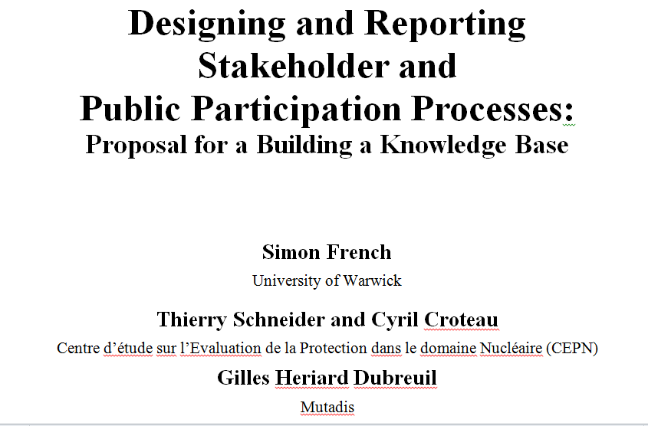
Stakeholder Knowledge Database

Slide 5
Breakout discussions
i) Why and how to preserve the knowledge base of stakeholder engagement;
ii) What elements need to be shared? What is meaningful? What is useful?
iii) What is the goal; and
iv) Who is the audience?
All groups supported the initiative and there was a consensus on the need to get started, and to provide a template and examples.

Slide 6
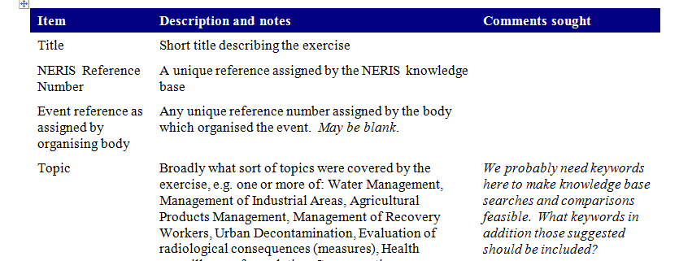
Database Compostition
Basic factual information
More general description
Evaluation according to several criteria
Other relevant documents and material uploaded as files.
Notes:
Basic factual information
It is notable how little factual information on stakeholder and public participation exercises is made available in published reports: how many attended, how they were selected, how long it took to arrange the meeting or activity, where it was held, what facilities were available, etc. Therefore, when one comes to design such exercises, generally one only has personal experience and that of close colleagues to fall back on. The aim of this section of the database is to collect such information. . Details are given in the Appendix
General description
This section is intended to contain a broad, freeform description of the exercise broken down under several general headings. The idea is not to constrain the reporting, but to enable it.

Slide 7
Factual Information
Topic
Who, how many, how, where…
Participation instruments and/or approaches
Facilites used
Chronology and dates of exercise
Costs, staff, resources, …
Notes:
Objective, factual information. The stuff that is hardly every reported in papers,…

Slide 8
General description
Context: geographical, technical, economic, political and social contexts, political governance structures; main players and stakeholders; …
Aims and deliverables
Process: how was the process decided upon, and why
Outcomes (factual rather than evaluative): Where the results of the exercise were sent and what happened subsequently. Who, in fact, took part: not just who was invited., …
Notes:
Diffcylty in drawing lines between this and above. But getting to be more subjectoive, needs to be more reflexive and not just crossing of catagories or filling in numbers. Stimulate further input from the participants

Slide 9
Evaluation Criteria
Information sharing: e.g., channels of communication, has it been one or two-way and, if two-way, a genuine dialogue?
Democratic Ideals: e.g. transparency, accountability, representativeness
Community cohesion: e.g., trust building, stakeholder and/or political acceptability
Practicability: costs, timescale, frequency
Decision quality: framing, structure
Notes:
This evaluation criterion should be broken down into five sub-criteria and the exercise evaluated – probably qualitatively – against these. Supporting evidence for the judgements made should be given.
Cost: Were the general costs and use of resources felt to be commensurate with the benefits gained from the process and did all stakeholders agree on this?
Timescales: Was the process felt to be conducted in a timely manner relative to the urgency of the issue(s) and did all stakeholders agree on this? Were stakeholders able to contribute within the available time windows?
Frequency: In the wider process of managing emergency preparedness and recovery, were there concerns for the amount of stakeholder participation required? Did this process risk stakeholder fatigue?

Slide 10
Next steps
Finalise the template and populate with examples
  Comments on document on NERIS webpage
  Working meeting in Manchester September 2013
  Review by experts “outside” the radiation protection community
  Technical issues and legal issues: web-based database; IT regulation
Presentation of the knowledge database at the NERIS Workshop in Oslo, 2014.
Notes:
Next Steps
We foresee the next steps in developing the knowledge base as:
Seeking views from across the NERIS community
Seeking views from selected experts in the evaluation of participatory processes from outside the ‘nuclear community’.
Investigating implications of European data and information protection laws as well as copyright laws for the maintenance of this knowledge base.
Beginning the technical specification and costing of the database and web interface systems to manage this knowledge base.
Once commissioned we would expect a year’s trial in which members of the NERIS community input at least one completed exercise and then critically evaluate whether they have been able to express all the issues that they have relating to the exercise, a fair assessment of its outcome and how this outcome related to the design of their process. Members of the community should also begin to enter details of any current exercise and similarly commit to entering future exercises as they occur. At the same time, a small research team without connection to any of the specific exercises recorded in the knowledge base should monitor and evaluate the process. As soon as sufficient exercises are entered, this team should also investigate whether elements of good practice are becoming clearer, and also begin documenting these with a view to building a handbook on the design of participatory exercises for contexts and groups of stakeholders that will specifically concern NERIS.
Finally, please comment on this document and its proposals. Any comments on any aspect will be very welcome. It is vital for the success of this initiative that we get the initial specification right. Comments should be sent to g.heriard-dubreuil@mutadis.fr and simon.french@mbs.ac.uk. Thank you.

