Slide 1

Belgian stakeholder panels
C.Turcanu, G.Olyslaegers, J.Camps
Society and Policy Support
cturcanu@sckcen.be; golyslae@sckcen.be; jcamps@sckcen.be
Kick-off meeting PREPARE WG3: Contaminated goods, CIEMAT, 23 May 2013, Madrid

Slide 2
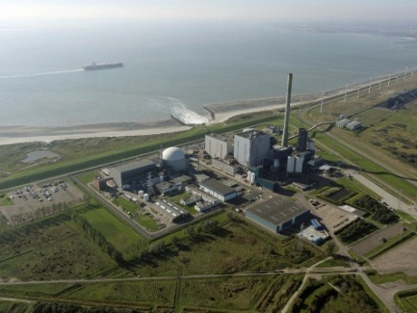
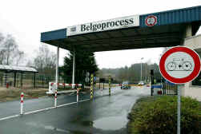
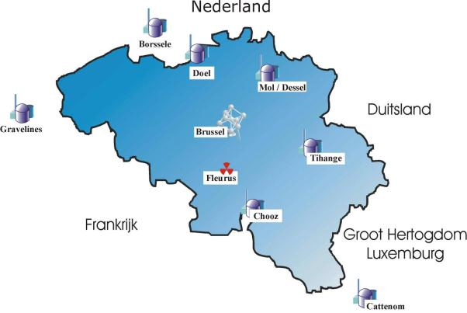
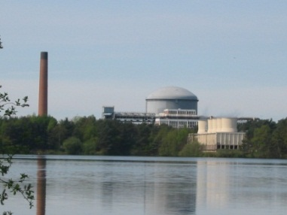
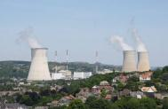
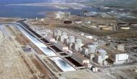
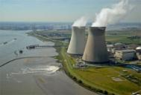
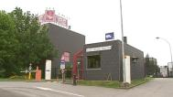
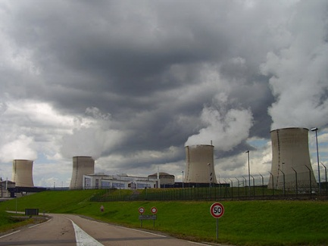
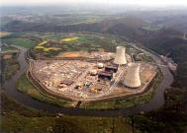
Nuclear installations in and around Belgium

Slide 3
Preliminary reflections
Two panels
  Panel 1: consumer goods (other than food)
  Panel 2: food

Slide 4
Tentative list of participating stakeholders
Panel on OTHER GOODS | Panel on FOOD
Regulatory authority: FANC/AFCN Federal Crisis Centre, Crisis centres of provinces Radioactive waste agency Interior Affairs Economic Affairs Radiation protection experts (e.g. SCK•CEN ) Monitoring labs (crisis situations, Fukushima, etc) Media Consumer organisations, NGO's Retailers
Controlling bodies: BELV, CONTROLATOM | Farmer’s union, e.g. Boerenbond
Airport, harbour or Antwerp, NMBS?, transport companies | Specific food industries, e.g. milk industry if this is discussed
Chamber of commerce | Food Agency FAVV/AFSCA
Civil Protection | Public Health
Companies (e.g. those requiring training after Fukushima) | Experts in communication & public opinion

Slide 5

Tentative list of participating stakeholders
Panel on OTHER GOODS | Panel on FOOD
Regulatory authority: FANC/AFCN Federal Crisis Centre, Crisis centres of provinces Radioactive waste agency Interior Affairs Economic Affairs Radiation protection experts (e.g. SCK•CEN ) Monitoring labs (crisis situations, Fukushima, etc) Media Consumer organisations, NGO's Retailers
Controlling bodies: BELV, CONTROLATOM | Farmer’s union, e.g. Boerenbond
Airport, harbour or Antwerp, NMBS?, transport companies | Specific food industries, e.g. milk industry if this is discussed
Chamber of commerce | Food Agency FAVV/AFSCA
Civil Protection | Public Health
Companies (e.g. those requiring training after Fukushima) | Experts in communication & public opinion

Slide 6
General approach
Wide range of stakeholders
Preparation
  An on-line policy Delphi could be organised to prepare the panels
    all the different opinions about the issue are gathered so that decision-makers can take informed decisions
    10-15 questions with Likert answering scale (strongly agree …. strongly disagree)
    special space dedicated to motivating the answer to each question, with possibility to go back and change the answer or edit at a later time (deadline for final version)
    Two loops: first the questions; next, a summary is prepared based on the answers, then the respondents can react to the summary for each question

Slide 7
General approach (ctd.)
Panel format
  Interactive workshops with 10-15 participants, e.g.
    Open process workshop
      Display process (emergency management) and ask people to present their opinion by sticking post-its; then summarise discussion
      10-15 participants need 1-2 moderators and 1-2 for taking notes and making links, etc
    Scenario workshop
      discuss a scenario step by step, giving additional information at each step
      ask people to say what they would do and identify problems
      establish if decision strategies are robust enough
Notes:
needs recording (at least audio)

Slide 8
Panel 1: consumer goods
  After Fukushima, two issues raised from companies that asked SCK•CEN for training
    Risk perception of the personnel working in factories receiving goods from Japan
    Risk perception of the public who might not buy products from Japan;
    → Training was given on radiation protection and measuring techniques
  Both in – and outside border accidental situations are important
  Some issues to be addressed:
    control;
    limits (for food they exist, but for other we only have exemption limits for transport → but would these be applied for e.g. toys?);
    communication to the public;
    handling of contaminated goods
    economic consequences

Slide 9
Panel 2: food
  Inside and outside borders situations
  Some issues to discuss
    What limits would be applied?
    Predefined limits or ad hoc limits for zoning ? Based on concentrations or administrative units?
    Control issues
    Would there be border controls if an accident happens, e.g. in Germany?
    Communication to the public

Slide 10
Supporting research / lessons learned from Fukushima
Non-food items:
  Actions by SCK•CEN after Fukushima
    Monitoring, training
Food
  FARMING outcomes
  Research on public acceptance and media
    Risk perception and acceptance of contaminated goods (SCK•CEN “Barometer” 2006, 2009)
    Media content analysis of reporting about food
    Factors determining the willingness to consume foods with residual radioactivity (SCK•CEN Barometer 2013 – forthcoming)
Include short presentations containing issues of relevance in the two panels

Slide 11

Instead of conclusions
Some particularities
  Different languages, cultural differences
  Split of authorities
We need a certain degree of harmonisation in approach and issues discussed among the panels

Slide 12
Copyright © 2013 - SCK•CEN
PLEASE NOTE!
This presentation contains data, information and formats for dedicated use ONLY and may not be copied, distributed or cited without the explicit permission of the SCK•CEN. If this has been obtained, please reference it as a “personal communication. By courtesy of SCK•CEN”.
SCK•CEN
Studiecentrum voor Kernenergie
Centre d'Etude de l'Energie Nucléaire
Belgian Nuclear Research Centre
Stichting van Openbaar Nut
Fondation d'Utilité Publique
Foundation of Public Utility
Registered Office: Avenue Herrmann-Debrouxlaan 40 – BE-1160 BRUSSELS
Operational Office: Boeretang 200 – BE-2400 MOL

