Slide 1
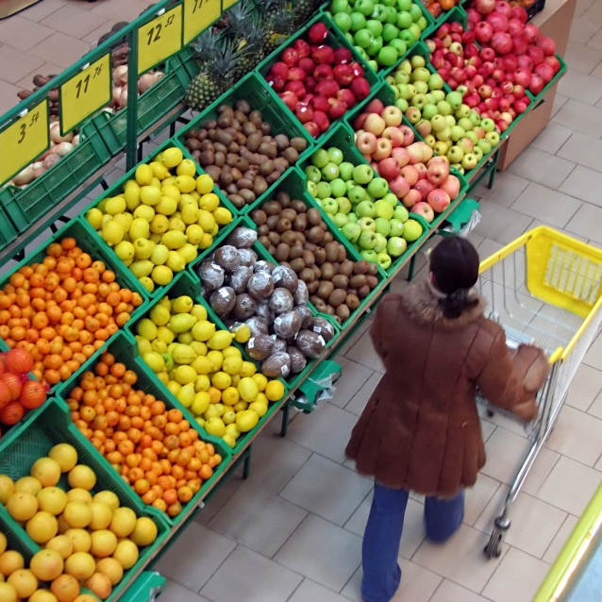


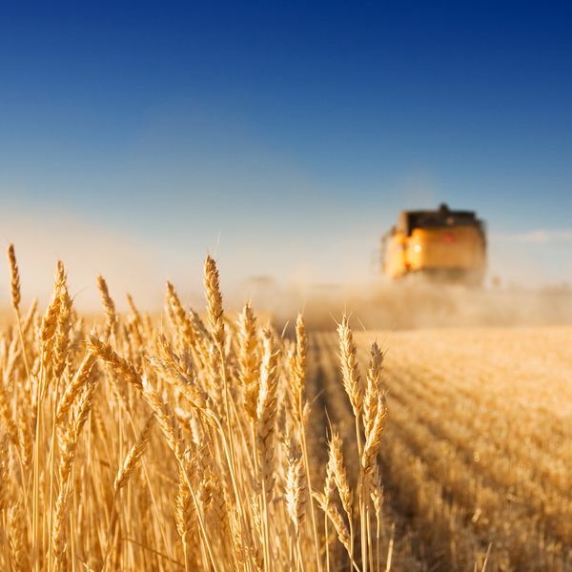
Radiological Protection in the Netherlands
Esther van Asselt

Slide 2
Products and stakeholders involved
Products: feed and food products
Stakeholders:
  BORI (RIVM, Ministries, NVWA, municipalities, RIKILT, KNMI, radiation protection specialists)
  Producers’ associations
  Cconsumers’ organizations, NGOs

Slide 3
Work plan
In-depth interviews with individual stakeholders: BORI members, producers’ associations (2013: 1PM)
Workshop with BORI members + producers’ associations (2014: 1PM)
Workshop with NGOs, consumer organizations (2014: 1PM)
Workshop with all stakeholders and final report (2015: 1 PM)

Slide 4
Questions:
Which data have been gathered in advance (section 4 of Food Handbook)
Which management structure is in place (section 5 of Food Handbook)?
  Which actions are taken in case of an incident?
  Who is responsible for which actions?
How is communication organized between the various stakeholders?
  What is monitored in case of incidents?
  Which lessons are learned from previous incidents?
  What expectations do NGOs and consumer groups have?

Slide 5
Outcome:
Scheme of actions and communications between stakeholders
Overview of expectations/concerns from society
Report on the actions, communication and responsibilities in the Netherlands in case of a radiological accident with recommendations for further improvements

