Slide 1

Mário Reis, Maria José Madruga
Instituto Superior Técnico
Campus Tecnológico e Nuclear
Estrada Nacional 10 (ao km 139,7), 2695-066 Bobadela LRS, Portugal

Slide 2
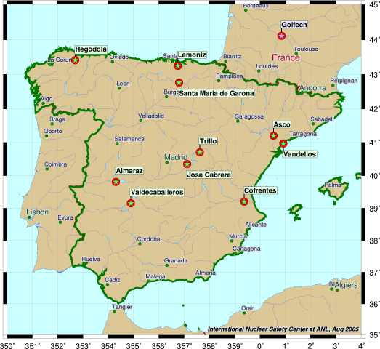
Portugal (no NPP)
- As a legal obligation conduct of environmental radioactivity survey, including foodstuffs (Art. 35 EURATOM Treaty)
-Regarding emergency exposure situations, has been involved only as a far distance country
However:
- Spain have several NPP (including Almaraz NPP, 100km distance of Portuguese border)

Slide 3
Chernobyl
- Increase the sampling frequency of foodstuffs (ex: milk and leafy vegetables)
- Radioactivity control of consumer goods imported mostly from European countries (powder milk, chocolat, etc;)
Fukushima
- Increase the sampling frequency of foodstufs (ex: milk and leafy vegetables)
Radioactivity control of consumer goods imported from Japan (spice, sauces, tea, etc.);
Routinely we carried out the radioactivity control of consumer goods exported, by request of producers and distributors, to countries that required certification of non radioactive contamination

Slide 4
Main objectives:
National Panels
To bring the national stakeholders to:
discuss different issues to be addressed in case of radiological emergency
understand the main concerns regarding the radioactivity control of goods
promote the exchange of experience with radiation protection experts
Should be considered:
Foodstuffs
Feedstuffs
Other consumer goods

Slide 5
Portuguese Stakeholders involved:
Governmental entities (General/Regional Directorates and Commissions from the Ministries of Agriculture, Fisheries, Environment, Economy, Interior, Science, etc.)
National Authorities and Regulatory Entities (on food safety, customs, transportation, civil protection, Water and Waste, etc.)
Radiological emergency planning and management authorities
Competent authorities in radiation protection (ex. IST/CTN)
National associations (consumer rights, water resources, etc.)
Producers of milk and foodstuffs
NGOs
Media

Slide 6
Issues to be addressed:
Monitoring of goods;
Harmonized reference levels;
Exemption-clearance concepts;
Strategies to deal with contaminated goods
Information and communication

Slide 7


Thank you for your attention

Slide 8
Portuguese Stakeholders involved:
Regional Directorates of Agriculture and Fisheries
APA – Portuguese Enviroment Agency
DGS – General Directorate for Health
IST/CTN (radiation protection experts)
IM – Meteorology Institute
IMT –Mobility and Transports Institute
CPEA – Agricultural Emergency Planning Commission
Agricultural and Food Planning Policy cabinet
ASAE – Authority for Food and Economic Safety
DGV – Portuguese National Authority for Animal Health
AT – Portuguese Customs and Taxes Authority
ERSAR – Regulatory Entity of Water and Waste Services
Water Supply Management Entities
INAC – Portuguese Civil Aviation Institute
ANPC - National Authority for Civil Protection
CNER – National Commission on Radiological Emergencies
Portuguese Association of Water Resources
DECO – Consumer Rights Association
Milk and foodstuffs producer companies
NGO on enviromental issues
Media

