Slide 1
Update of ICRP Publication 109 and 111
Michiaki KAI, Ph.D
Chair TG93, ICRP Committee 4
NERIS meeting in Paris, 11-12 April,2016

Slide 2
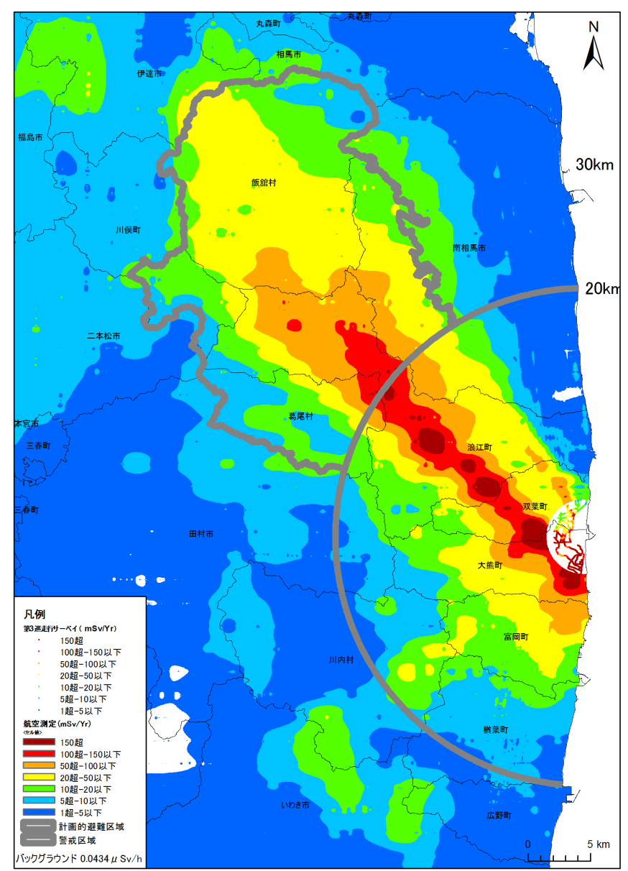
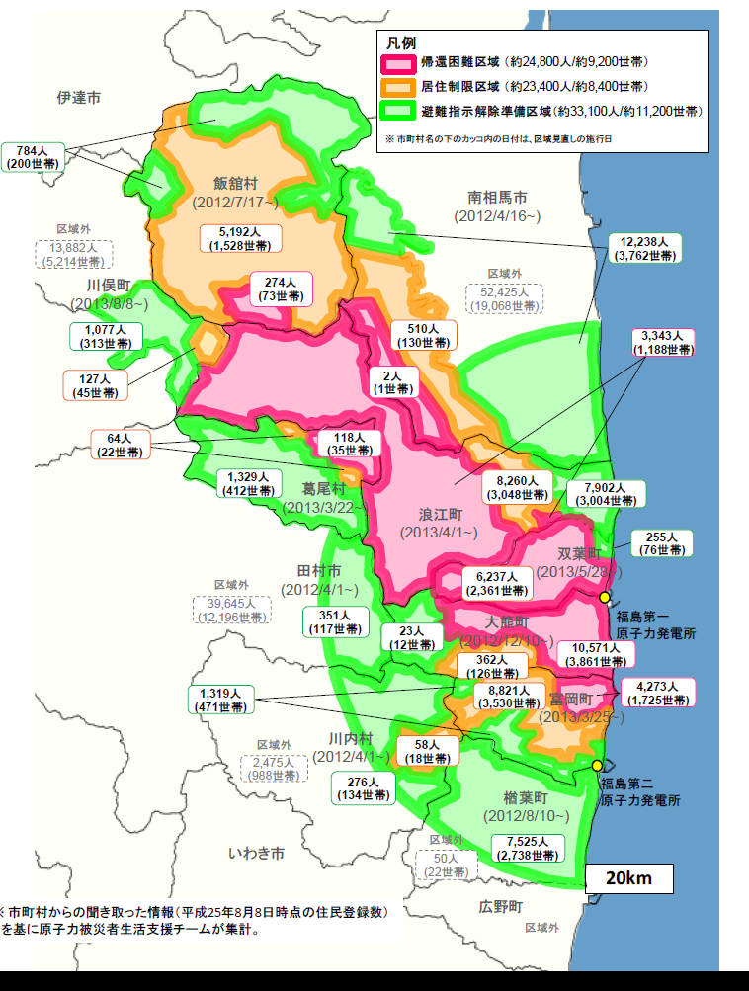
4
Evacuation :
Fukushima : 146,000 people
Exclusion zone : 81,300
Area 3 ( 50mSv< ) : 24,800
Area 2 (20 - 50mSv): 23,400
Area 1 ( 20mSv> ) : 33,100
Lifted on 1 April 2014
Miyakoji, Tamura city
Lifted on 1 October 2014
Kawauch village
Notes:
Before talking the detail, just I would like to introduce the situation now in Fukushima prefecture.
Since Government Nuclear Emergency Response Headquarters announced the rearrangement of the restricted areas within a 20km radius and deliberate evacuation areas on 26 December 2011, the first lifting of evacuation order was made on 1 April 2014 from the Miyakoji district of Tamura city.
But only 81 evacuees, about 23% of the residents have been returned on 23 May.
The residents of Kawauchi village are now allowed to stay overnights till the end of July for 3 months, then they will decide whether to return.
The third candidate, Naraha town is preparing the discussion of return home.

Slide 3
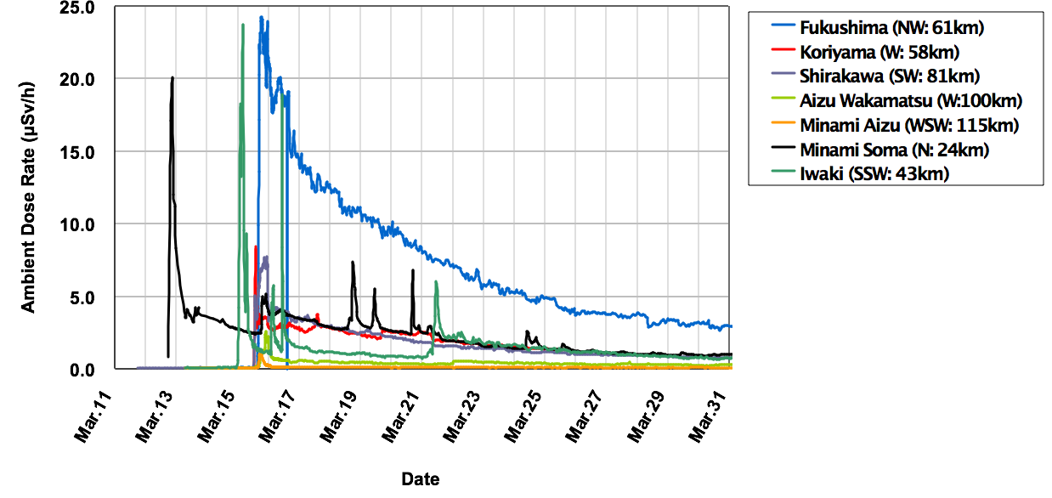
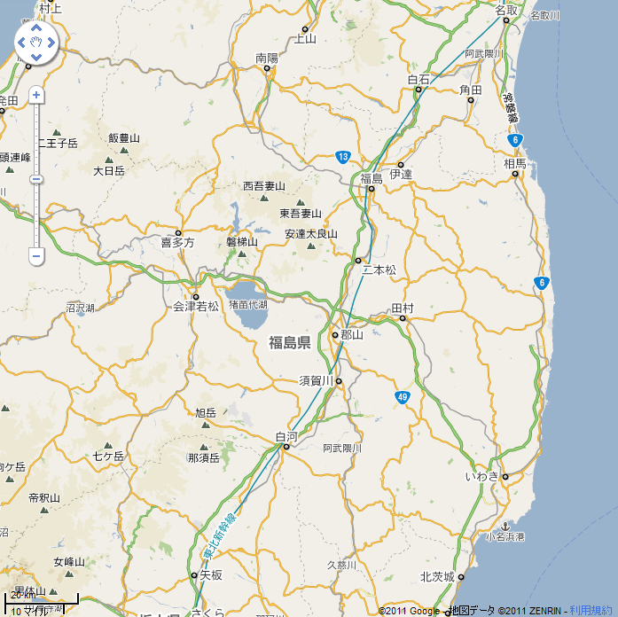
5
Radiological situation and corresponding protective actions
Precautionary urgent protective actions (evacuation, sheltering)
Urgent protective actions (foodstuff and water restrictions)
Early protective actions (preparation for temporary relocation)
Fukushima
Minami
Soma
Aizu Wakamatsu
Koriyama
1F NPP
20km
30km
Minami
Aizu
2F NPP
Shirakawa
Iwaki
Prolonged releases with multi-unit events
20km
Notes:
This shows the radiological situation at the accident.
In the area of the Fukushima Daiichi, the circulation of sea and land breezes is a predominant factor for dispersion of released radioactivity.
At night, the wind blows toward the sea.
In the early morning, it shifts to the south, and during the daytime wind direction changes clockwise.
This first peak on 12 of March was observed at Minami-soma about 20km north of the plant. This might be resulted from the releases at Unit 1.
The releases from Unit 3 during 13th were transported toward the sea.
The major release from Unit 2 was first observed at Iwaki in the morning on 15th. After that, in the afternoon, the plume reached the cities of Shirakawa, Koriyama and Fukushima and the airborne radiation levels rose.
In the evening, the entire prefecture of Fukushima experienced rain and snow, depositing the radioactivity on the ground during the plume passage.
The areas to the northwest of the plant were thus highly contaminated.
After this event, drinking water and food restrictions were taken first on March 21 and the consideration of temporary relocation outside the evacuation zone began.

Slide 4
Background
ICRP Publications 109 and 111 were issued in 2009 (23 years after the Chernobyl accident)
First Publications implementing the new Recommendations of the Commission (Publication 103, 2007)
When the Fukushima accident occurred no authority in the world had had the time to analyze and integrate the advice of Publications 109 and 111 in regulation. However they have been influential in the management of the accident but not always well understood and applied
Soon after the accident ICRP Task Group 84 was established to draw the ‘Initial Lessons from the NPP Accident in Japan vis-à-vis the ICRP System of Radiological Protection’
Released in November 2012, the Summary of the Task Group report highlighted several points requiring clarification and additions in Publications 109 and 111
4

Slide 5
Key issues in update of Publication 109
Timeline of situations and protective measures in emergency management
Justification of protective measures (more good than harm with taking into account non-radiological consequences)
Optimisation of protection strategies in emergency
  The ICRP concept of optimising whole protection strategies (i.e. response through to recovery/rehabilitation) is useful for planning purposes but very difficult to implement in practice.
  There is a need for more specific guidance on how to carry out optimisation following an accident.
  Reference levels and intervention levels
Lifting protective measures
Criteria for the transition from emergency to existing exposure situations
Environmental monitoring and health surveillance
Foodstuff and contaminated waste management
Radiation protection of responders

Slide 6
Key issues in update of Publication 111
Living in contaminated areas is an existing exposure situation
The protection strategy should do more good than harm
Implementation of protection strategy
  Protection actions implemented by authorities
  Self-help protection and radiation protection culture
Reference levels
Non-radiological aspects and human dimension
Engaging local stakeholders
Environmental monitoring and health surveillance
Foodstuff management
Radiation protection of recovery workers

Slide 7
ICRP Task Group on the update of Publications 109 and 111
Michiaki Kai, Japan (Chair)
Toshimitsu Homma, Japan (Vice-chair)
Anne Nisbet, UK
Thierry Schneider, France
Victor Averin, Belarus
Ralph Andersen, USA
Corresponding Members:
Miroslav Pinak (IAEA) Ted Lazo (NEA/CRPPH)
Collaboration with:
Fukushima dialogue stakeholders
ICRP members:
Jacques Lochard (MC), Chris Clement (Scientific Secretary),
Jean-François Lecomte (C4), Ohtsura Niwa (MC),
Nobuhiko Ban (C1)
7
Notes:
7

Slide 8
TG93 and related meetings held
TG93 meetings
1st 28-29, Nov, 2013 Fukushima
2nd 8-9, May, 2014 Fukushima
3rd 28-30, Nov. 2014 Paris
4th 30 Mar. – 1 Apr., 2015 Paris
5th 8-10, July, 2015 Tokyo
ICRP dialogue meetings
12 meetings during Nov. 2011 - Sep. 2015, Fukushima
Stakeholder meeting
6-7, July, 2015 Tokyo

Slide 9
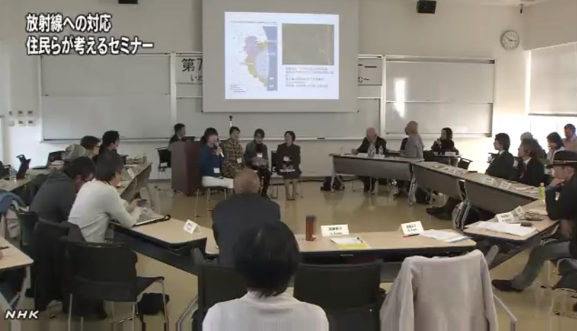
7th ICRP dialogue seminar in Iwaki – November 2013
9

Slide 10
Task Group 93 draft report
Application of the Commission’s Recommendations
for the protection of people in the event of a large nuclear accident
- Update of Publications 109 and 111 -
Contents
Editorial: From Chernobyl to Fukushima
Abstract
Preface
Main points/Executive summary
Glossary
1. INTRODUCTION
2. GENERAL CONSIDERATIONS
3. EMERGENCY
4. RECOVERY
5. CONCLUSION
ANNEX
A.1. Chernobyl
A.2. Fukushima
10

Slide 11
CONTENTS 1
1. INTRODUCTION
1.1. Background
1.2. Scope
1.3. Structure of the report
2. GENERAL CONSIDERATIONS
2.1. Accident timeline
2.2. Effects of nuclear accidents
2.2.1 Health effects
2.2.2 Societal effects
2.2.3 Environmental effects
2.3. Protection of people and the environment
2.3.1 Objective of the protection
2.3.2 Principle of justification
2.3.3 Principle of optimisation
2.3.3.1 Reference levels
2.4. Stakeholder involvement
2.5. Emergency and Recovery Preparedness
11

Slide 12
CONTENTS 2
3. EMERGENCY
3.1. Characteristics of the emergency phase
3.2. Protection strategies
3.3. Protection of the public
3.3.1 Radiological characterization
3.3.3.1 Environmental monitoring
3.3.3.2 Individual monitoring
3.3.2. Protective actions
3.3.2.1 Evacuation and relocation
3.3.2.2 Sheltering
3.3.2.3 Iodine thyroid blocking
3.3.2.4 Food
3.3.2.5 Decontamination of people
3.3.3. Termination of protective actions
3.4. Protection of emergency responders
3.5. Preparing for recovery
12

Slide 13
CONTENTS 3
4. RECOVERY
4.1. Characteristics of the recovery phase
4.2. Protection strategies
4.3. Protection of the public
4.3.1 Ongoing monitoring and surveillance
4.3.1.1 Radiation monitoring
Environmental monitoring
Individual monitoring
4.3.1.2 Health surveillance
4.3.2. Protective actions for the public
4.3.2.1 Foodstuff management
4.3.2.2 Remediation
4.3.2.3 Waste management
4.3.3. Co-expertise, radiological protection culture and self-help protection
4.4. Protection of recovery responders
4.5. Protection of the environment
4.6. Evolution and termination of protective actions
13

Slide 14
2.1. Accident timeline (1)
- Based on Publications 40 and 109 -
  In the present publication the Commission is adopting the following sequential time phases to characterize the timeline of the accident
Preparedness | Emergency phase |  | Recovery phase
 | Early phase | Intermediate phase
The intermediate phase of the response is identified as the period of time when either the source has been brought under control or the release has been terminated, and radioactive contamination is present in the environment.
14

Slide 15
2.1 Accident timeline (2)
Reactor stabilized
Emergency phase
Recovery phase
Early phase
Intermediate
phase
Characterization
Existing exposure situation
On site
Emergency exposure situation
Off site
Emergency exposure situation
Existing exposure situation
Characterization
Fukushima
Dec. 2011
April 2012
Fig. Relations between Phases and Exposure situations

Slide 16
  2.2. The effects of a nuclear accident
  2.2.2 Societal effects
Personal and interpersonal impacts (Human dimension)
Loss of control and autonomy of people and apprehension of their future
Serious disturbances of daily life
Disintegration of family and social relationship
Distancing from the familiar environment
Psychological effects
Loss of trust in authorities and experts
Strong concerns about potential health effects particularly for children
General feeling of helplessness and abandonment
General feeling of discrimination and exclusion reinforced by the look and attitude of outsiders
Social and economic impacts
16

Slide 17
  2.3.2. Principle of justification
The principle of justification of decisions: any decision that alters a radiation exposure situation should do more good than harm
  This principle refers to the ethical value of beneficence/non-maleficence
Fukushima experience
  Evacuation from nursing homes, where elderly or medically-supervised people stay, may induce higher risk for patients as compared with radiation risk associated with doses in the range of a few 100 mSv. Risks to patients care staff should be considered.
  (Murakami,2015)
  The experience of the Fukushima accident suggests that evacuation of the elderly was not the best life-saving strategy (Nomura, 2013). This was at least partly due to inadequate preparations to care for such patients during transport and at evacuation centers.
17

Slide 18
  2.3.3. Principle of optimisation
The principle of optimisation of protection: all exposures should be kept as low as reasonably achievable with restrictions on individual exposures to limit inequity between individuals
  This principle of optimisation of protection, with a restriction on individual dose is central to the system of protection. It applies fully to any exposure situations
  This principle refers to the ethical values of Beneficicence/non-maleficence, Prudence, Justice and Dignity
ICRP TG : Ethical Foundations of the System
of Radiological Protection
18

Slide 19
  2.3.3.1 Reference levels
Reference level: In emergency and existing exposure situations, the reference level represents the dose above which, it is judged to be inappropriate to allow exposures to occur and for which, therefore, protective actions should be implemented.
Reference levels are guides for selecting protective actions in the optimisation process in order to maintain individual doses as low as reasonably achievable taking into account economic and societal factors and thus prevent and reduce inequities in the dose distribution.
As such, reference levels are also a benchmark against which protective actions can be judged retrospectively.
The selected reference value is not a dose limit but represents the level of dose below which exposure should be maintained and reduced as low as reasonably achievable taking into account societal and economic factors.
19

Slide 20
Reference levels for optimising protection in case of nuclear accidents
 | Emergency exposure situation | Existing exposure situation
Public | 100 mSv or lower ª | 10 mSv/y or lower ^{a,b} The long term goal is to reduce exposures to the range of 1 mSv/y or less
Responders (See table responders) | 100 mSv or lower ^{a,c} Could be exceeded in exceptional circumstances | 20 mSv/y or lower ª
a)
b)
c)
Previously the Commission recommended selection of reference levels in the bands of 1-20 and 20-100 mSv or mSv/y. Although these bands continue to be relevant in many circumstances, the current recommendation recognizes that under some circumstances lower reference levels than 20 for emergency and 1 for existing may be appropriate.
This clarifies the previous recommendation of the Commission to select of reference levels for the optimization of protection of people living in contaminated areas in the lower part of the 1-20 mSv/y band.
The Commission continues to recommend to take all practicable actions to not exceed 1000 mSv to avoid severe deterministic effects for responders involved in an emergency exposure situation (Ref. ICRP Pub.118).
20

Slide 21
  2.4. Stakeholder involvement (1)
Stakeholder involvement: In Publication 103, the Commission mentions, for the first time, the need to account for the views and concerns of stakeholders when optimising protection
Who are community stakeholders?
  local professionals, local administrators, local community workers (medical doctors, nurses, teachers, etc), representative of NGO, interested individuals.
    Why to engage the affected people ?
        To take into account their concerns and expectations as well as the prevailing circumstances of the exposure situation
        To adopt more effective and fairer protection actions
        To favour their empowerment and autonomy i.e. to promote their dignity
21

Slide 22
  2.4. Stakeholder involvement (2)
To involve stakeholders in the post-accident management raises questions such as:
  Is this a strategy to let individuals alone to face the post-accident situation?
  Is there not a risk of manipulation inasmuch as being involved, individuals would be forced to accept the situation?
  Is there not a risk of leading to the disengagement of the responsibility of authorities and experts?
Some ethical principles
  Authorities and experts must be at the service of improving the protection and living conditions for the population
  Respect of the autonomy and freedom of individual when taking decisions committing their future
22
Notes:
22

Slide 23
  2.4. Stakeholder involvement (3)
Chernobyl and Fukushima experience have demonstrated that empowerment of affected people is:
  A way to help them to regain freedom, to make informed decision and to act accordingly, i.e. to regain dignity
  An effective way to reduce exposure as low as reasonable by contributing to the development of prudent attitude and vigilance towards exposure and favouring adoption of efficient and sustainable protection strategies (optimisation principle)
In the case of post-accident situations (typical existing exposure situation) optimisation is not only focussed on dose reduction but also on improving living conditions of the affected people (well-being).
23

Slide 24
Emergency

Slide 25
3.1. Characteristics of emergency
- Exposure pathways and protective actions -
Preparedness | Emergency phase |  | Recovery phase
 | Early phase | Intermediate phase
    Exposure pathways
    cloudshine, inhalation
    groundshine, resuspension
    ingestion
    Protective actions
    no actions
    sheltering
    evacuation
    relocation
    iodine
    food ban
lifting
lifting
lifting
25

Slide 26
  3.2. Protection strategies (1)
  Urgent actions include sheltering, distribution of iodine and, evacuation as mechanisms designed to “quickly” avoid or reduce exposures
  Key decision to be taken by authorities is to decide whether evacuated people must be temporarily relocated or they can return rapidly to either maintaining economic activities or to residing again in their homes
  All decisions have strong technical, economic, societal and political implications
26

Slide 27
  3.2. Protection strategies (2)
    Predefined reference levels may need to be quickly revisited to fit the prevailing circumstances with taking into account the actual dose distributions.
    Triggers that can be expressed in terms of any observable circumstances or directly measurable quantities can be used as surrogates of references levels for practical reasons
27

Slide 28
  3.3.1 Radiological characterisation
Early phase
  The results of environmental monitoring should become available to aid decisions on the implementation of both urgent food and water restrictions and extended protective actions (eg. Relocation).
  The need for very early individual monitoring (thyroid measurements, and relatively early WBC measurements) should be emphasized.
Intermediate phase
  Detailed environmental monitoring is essential for understanding the radiological situation of contaminated areas and for terminating urgent protective actions.
28
Notes:
28

Slide 29
  3.3.2.4 Food (1)
  Foodstuff management should consider both protection of people and maintaining food supply in the affected areas
  Banning food temporarily is an option
  Criteria may be below or above Codex values; specific criteria may be set locally
  Early phase: prompt reaction taking account the prevailing circumstances in order to protect both people and image of products (zoning, ban or restrictions, first criteria)
  Intermediate phase: characterisation of the situation (measurements), recovery actions, involvement of stakeholders, evolution of the strategy and criteria
29
Notes:
29

Slide 30
  3.3.2.4. Food (2)
  Once an accident has occurred it will be necessary to use the detailed understanding of the prevailing circumstances to develop criteria that specifically address the food products
  Food criteria should be situation-specific to address the accident
  They will be developed at the time of an accident, based on generic levels needed for reflex actions
  Criteria will most likely evolve as the prevailing circumstances change.
  Accident-specific national criteria should then drive international, accident-related criteria for allowing the importation of food from the accident country; these national export criteria should be considered for use by importing countries
30

Slide 31
  3.3.3 Termination of protective actions (1)
  - Return from evacuation -
The Commission does not recommend any particular radiation protection criterion. If any is selected, it must be consistent with the guidance concerning the management for existing exposure situations
The decision must be taken by the authorities on a case by case basis taking into account the prevailing circumstances i.e. :
  The current residual level of exposure in the affected places and the level reasonably expected in the near future given the proposed remediation actions
  The conditions and means to maintain sustainable societal and economic living conditions of the affected population in these places
Individuals have a basic right to decide whether to return or not. Difficult to answer this dilemma solely on the basis of radiation protection considerations. All decisions must be supported by authorities
31

Slide 32
  3.3.3 Termination of protective actions (2)
    The decision to terminate individual protective measures will need to reflect the prevailing circumstances of the emergency exposure situation. The decisions to terminate protective measures should have due regard for the appropriate reference level.
32

Slide 33
  3.4. Protection of emergency responders (1)
  - General considerations and principles -
Specific management of responders compared to occupationally exposed workers; dose treated separately
Graded approach
  Distinction on-site (damaged installation) versus off-site (affected areas)
  Distinction between phases: early, intermediate, late
  The tasks likely to provide higher doses should be completed by responders already prepared and trained
Justification of decisions: benefit (avoid or reduce exposure for population and contamination of environment) > disadvantages (notably risk for responders)
Optimisation: limited and specific implementation in the early and intermediate phases (unforeseen event, no experience, uncertainties)
Application of the dose limits: a priori not relevant

Slide 34
Reference levels for emergency responders
 | Emergency exposure situation
 | Early phase | Intermediate phase
On site
Dedicated team Emergency responders Plant and outside workers | 100 mSv or below higher in special circumstances | 100 mSv/y or below might evolve with circumstances
Off site
Emergency team | 100 mSv or below higher in special circumstances | 20 mSv/y or below might evolve with circumstances
Skilled workers and other responders

Slide 35
  3.4. Protection of emergency responders (2)
  - Cumulative exposure -
100 mSv as a maximum for a RL is an order of magnitude
Ensure that the working-lifetime dose does not exceed a few hundreds of mSv
Appropriate health surveillance
Medical examination before back to regular job (as occupationally exposed worker)

Slide 36
  3.5. Preparing for recovery
  Characterisation of the exposure situation
  It is a prerequisite to take control of the exposures
  This process can be considered as achieved when the authorities have a fairly good knowledge of where, when, and how people are exposed (and will be exposed in the future) in the affected areas
  The exposure situation needs to be characterized :
    For the authorities to decide about permanent relocation and/or return home and the most effective protection strategy
    For the population to decide to leave or to stay and engage into self-help protection with the support of authorities and experts
  The shift from the emergency to the existing exposure situation is a decision taken by authorities when they have enough information to consider that the exposures can be reasonably controlled and the recovery phase can start to deal with the long-term.
36

Slide 37
Recovery

Slide 38
  4.1. Characteristics of the recovery phase (1)
  Living in contaminated environment is a complex situation generating a lot of concern among the affected population
  Limited number of significant radionuclides. The dominant pathway can be either ingestion (Chernobyl) or external irradiation (Fukushima)
  Exposure are driven by individual behaviours and the and socio-economic situation. Large individual dose distribution (Log-normal)
  Protection strategies include actions implemented by authorities at the national and local levels and by affected population itself = self help protection actions
  Responsibility of authorities to establish programmes for continuous radiation monitoring, health surveillance, information and education to allow the effective engagement of the affected population
38

Slide 39
  4.1. Characteristics of the recovery phase (2)
The human consequences of the accident are massive and lasting
Expertise and support must be at the service of local citizens
Individual monitoring (internal and external) and self-measurement of land and foodstuff are essential, and require outside support
Radiation protection culture is at least as important as remediation to improve safety and a feeling of security
Local communities must be engaged in developing improvement projects and in assessing progress
Success depends on the combined action of authorities and self-help actions implemented by the affected population
39
Notes:
Add the role of experts
39

Slide 40
  4.1. Characteristics of the recovery phase (3)
Every individual choice is respectable and the radiological protection system must be neutral with regard these choices.
  It is the responsibility of authorities to implement reference levels to reduce the risk and to restrict inequity between individual exposures.
It is the responsibility of authorities to implement protection actions:
  Based on the respect of individual choices and decisions
  Based on a sufficiently fair support to allow individuals the freedom of choice and informed decisions
  A key challenge for radiation protection professionals is to prepare themselves to be at the service of inhabitants and their concerns and to support participative decision-making processes in which radiological protection is only one aspect
40

Slide 41
  4.2. Protection strategies (1)
Justification of the protection strategy
  Decision taken by the authorities at the end of the emergency exposure situation, to allow people to live permanently in the long term contaminated territories in conjunction with the setting of radiological protection criterion and the implementation of a set of protection actions judged to do more good than harm
  Mandatory relocation may be necessary
  Voluntary relocation should be always possible
Optimization of the protection strategy
  Transparent step by step process to reduce and maintain exposures ALARA with the use of a reference level to restrict individual exposures taking into account the prevailing circumstances

Slide 42
  4.2. Protection strategies (2)
  - Optimization -
A combination of protection actions implemented by authorities at the national and local level and by the affected population itself
= self help protection actions
Past experience has demonstrated that the involvement of local authorities, professionals and inhabitants in the implementation of protection strategies is key to the success and sustainability of rehabilitation programs
It is the responsibility of authorities to establish conditions to allow the effective engagement of the population and particularly to provide the means to individuals to have access to their own exposure exposures through individual measurements
42

Slide 43
  4.2. Protection strategies (3)
  - Optimization -
Evaluation of exposure situations to identify the need for action – Where , when and how people are exposed
Identification of protective actions – Decontamination, soil remediation and adaptation of agriculture, management of contaminated foodstuffs and commodities, waste management,… and self-help protection actions
Selection of the best actions under the prevailing circumstances - Priority is to protect people with the highest exposure, and in parallel to reduce all exposures ALARA
Implementation of the protective actions – By national and local authorities and by the affected stakeholders
Evaluation of the performance – On going monitoring of individual exposures and health surveillance of the population
43

Slide 44
  4.3.1 On-going monitoring and surveillance (1)
  - Radiation monitoring -
The objective is the monitoring of the levels of contamination in the environment in order to assess the current levels of exposure of individuals (both external and internal) and to allow the prediction of their evolution in the future
  Radiation monitoring should provide measurements of
    Individual external dose
    Ambient dose rates
    Concentrations of radionuclides in foodstuffs, commodities and in the environment
    Whole-body contamination of individuals.
The effectiveness of the monitoring system relies on its ability to cope with local particularities
  Individual monitoring is effective to support communication with affected people.
44

Slide 45
  4.3.1 On-going monitoring and surveillance (2)
  - Health surveillance -
Experiences suggest that both radiological and post-accident stress aspects of health need to be addressed
To plan and implement a system for long term monitoring of the health status of the affected population
Stakeholder concerns and input should be clearly and transparently included in designing the health surveillance program
Healthcare professionals should support affected people to understand their radiological and health situation
Public health authorities need to consider the well-being of the population for promoting health rather than just addressing radiation risk
Mitigation of social and psychological impacts should be taken into account
45
Notes:
45

Slide 46
  4.3.2.1. Foodstuff management (1)
General considerations
  Very sensitive issue, especially for children
  Ingestion may be important pathway for local population
  Production, consumption and distribution are controllable
  Future of agriculture in contaminated area is challenged
  Many dimensions are affected : health, environmental, societal, economic, etc.
  Variable situation, depending on the severity of the accident and the vulnerability of the areas affected
  Exposures are depending on individual behaviours, e.g. local garden, sansai,…
  Consumers/producers/distributers may have different interests
46

Slide 47
  4.3.2.1. Foodstuff management (2)
  Foodstuff management should consider both protection of people and the sustainable development in affected territory
  Criteria may be below or above Codex values; specific criteria may be set locally
  Late phase: long-term criteria, continuation of recovery actions as necessary, dissemination of RP culture, self-help actions, action towards most exposed people
  Note: Early and intermediate phases are described in Section
  3.3.2.4 of EMERGENCY
47

Slide 48
4.3.3. Co-expertise, RP culture and self-help protection (1)
- The role of experts -
    To characterise the radiological situation with measurements
    To aid the decision making process about protective actions
    To inform about the radiological situation and disseminate good practice
    To train professional community workers: teachers, nurses,…
  But the key role of experts is to work with the affected individuals and communities
    To bring practical responses to their concerns, needs and expectations
    To help them to regain their autonomy, that is to say their ability to make informed decisions given the prevailing circumstances
    To restore social trust in the affected areas
48

Slide 49
4.3.3. Co-expertise, RP culture and self-help protection (2)
- The co-expertise process -
This process relies on:
    The establishment of places for dialogue allowing experts to listen and to discuss together with affected people about their questions, concerns, challenges,…
    An assessment of the radiological situation conducted jointly by local inhabitants and experts in order to identify the room for manoeuver to improve this situation taking into account the prevailing circumstances for the individuals and the community
    The implementation of local projects to address the problems identified at the individual and the community levels with the support of local authorities, experts and professional community workers
    The evaluation and dissemination of results
49
Notes:
12/04/16
49

Slide 50
  4.3.3. Co-expertise, RP culture and self-help protection (3)
  - The development of the practical radiological protection culture -
  The co-expertise process facilitates the emergence of a practical radiological protection culture among the affected communities, gradually allowing people:
    To interpret results of measurements: ambient levels, external and internal doses, contamination of products
    To orient themselves in relation to radioactivity in everyday life by understanding where, when and how they are exposed
    To build their own benchmarks against radioactivity in day-to-day life
    To gather elements to make informed decisions and take actions = self-help protection
    To judge the effectiveness of the protective actions they implement themselves and those implemented by the authorities
50
Notes:
12/04/16
50

Slide 51
  4.3.3. Co-expertise, RP culture and self-help protection (4)
  - The development of the practical radiological protection culture -
  A proposed definition:
  the knowledge, skills and resources enabling citizens and communities to make informed and effective choices and to act wiselyin situations involving exposureto ionizing radiation
  Individual measurements with suitable devices is critical to ensure the development of this culture
  The development of a practical radiological protection culture is a decisive factor for each individual to restore her/his autonomy of decision with regard the radiological situation i.e. to regain control on her/his daily life
51
Notes:
12/04/16
51

Slide 52
  4.3.3. Co-expertise, RP culture and self-help protection (5)
  - Summary-
Citizens dialogue with experts and authorities and engage themselves in the recovery process
They progressively understand when, where, and how they are exposed and what they can do to control their exposures
They take effective actions to improve their living conditions
Co-expertise
Practical radiological protection culture
Self-help Protection
52

Slide 53
  4.4. Protection of recovery responders (1)
  - On site recovery phase-
WHO?:
  Regular workers (occupationally exposed)
  Possibility of a specific status for a limited period of time
Requisites:
  Occupational requisites
  Learning process
  Decent conditions of work
  Reference level: see table for recovery responders
53

Slide 54
  4.4. Protection of recovery responders (2)
  - Off site recovery phase-
General :
  Close to normal situation (taking into account mixed population)
  Recovery in places not open to the public: occupational exposure
  Recovery in places open to the public: public exposure
  Self-help actions: public exposure
  Common job in affected areas: public exposure (a few exceptions)
Requisites:
  Identification (may be just-in-time)
  Information about tasks and risks (right to know)
  Traceability of exposure (dose assessment and information kept but not necessarily on an individual basis)
  Information about the dose received
Reference level: see table for recovery responders

Slide 55
Reference levels for recovery responders
 | Existing exposure situation
On site
Regular workers Outside workers | 20 mSv/y or below possible special dispensation
Off site
Skilled workers and other responders | 20 mSv/y or below In restricted areas 10 mSv/y or below in public areas

Slide 56

www.icrp.org
www.icrp.org

