Slide 1
Update of ICRP Publication 109 and 111
Michiaki KAI, Ph.D
Chair TG93, ICRP Committee 4
NERIS meeting in Paris, 11-12 April,2016

Slide 2
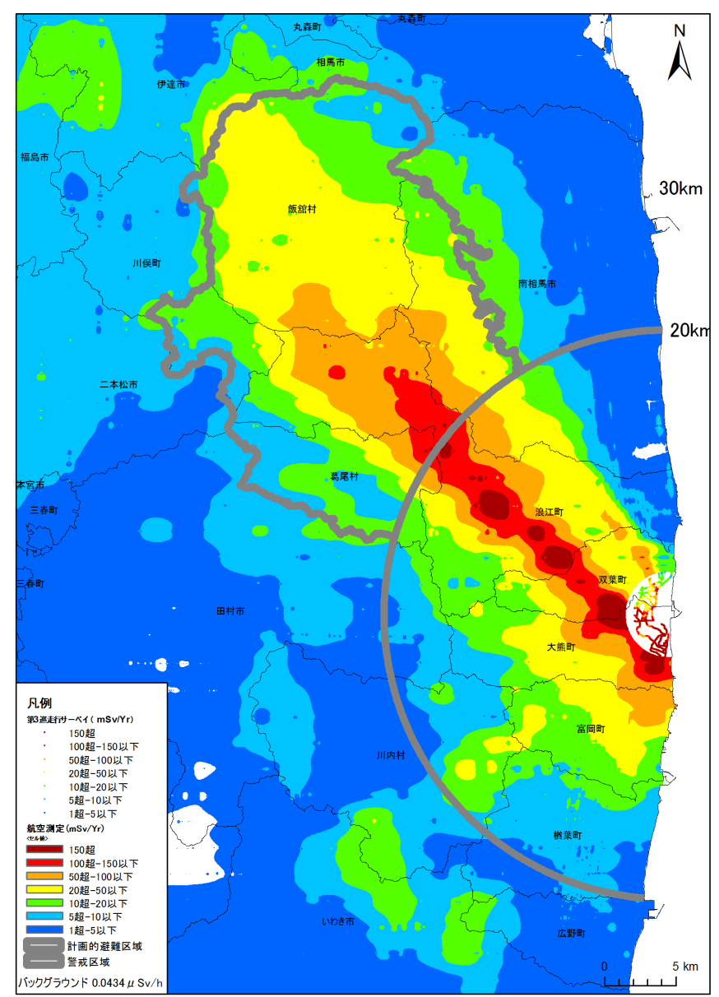
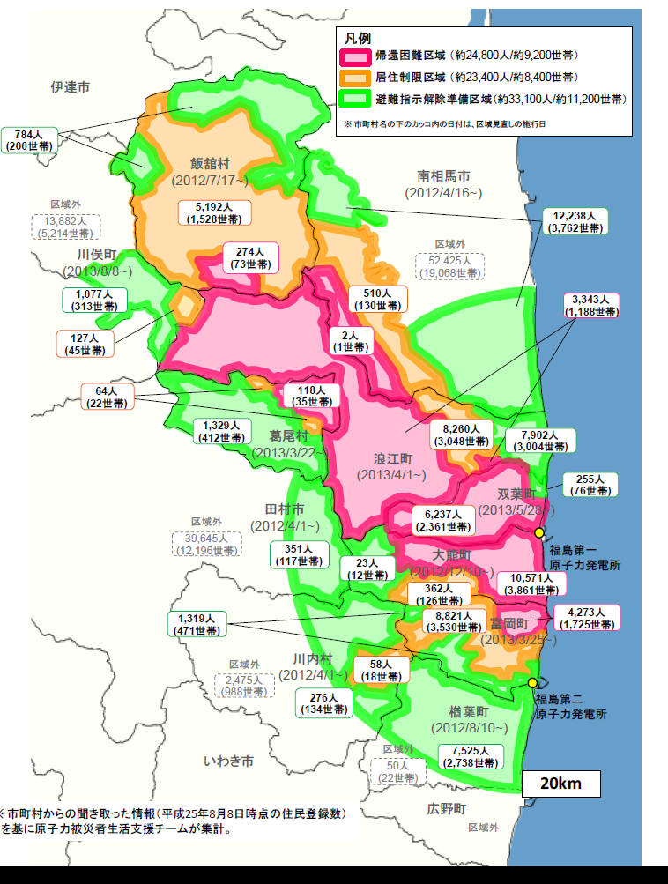
4
Evacuation :
Fukushima : 146,000 people
Exclusion zone : 81,300
Area 3 ( 50mSv< ) : 24,800
Area 2 (20 - 50mSv): 23,400
Area 1 ( 20mSv> ) : 33,100
Lifted on 1 April 2014
Miyakoji, Tamura city
Lifted on 1 October 2014
Kawauch village
Notes:
Before talking the detail, just I would like to introduce the situation now in Fukushima prefecture.
Since Government Nuclear Emergency Response Headquarters announced the rearrangement of the restricted areas within a 20km radius and deliberate evacuation areas on 26 December 2011, the first lifting of evacuation order was made on 1 April 2014 from the Miyakoji district of Tamura city.
But only 81 evacuees, about 23% of the residents have been returned on 23 May.
The residents of Kawauchi village are now allowed to stay overnights till the end of July for 3 months, then they will decide whether to return.
The third candidate, Naraha town is preparing the discussion of return home.

Slide 3
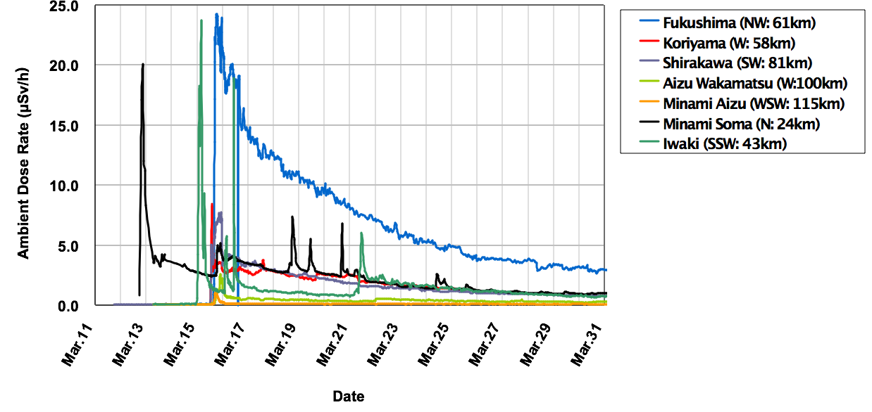
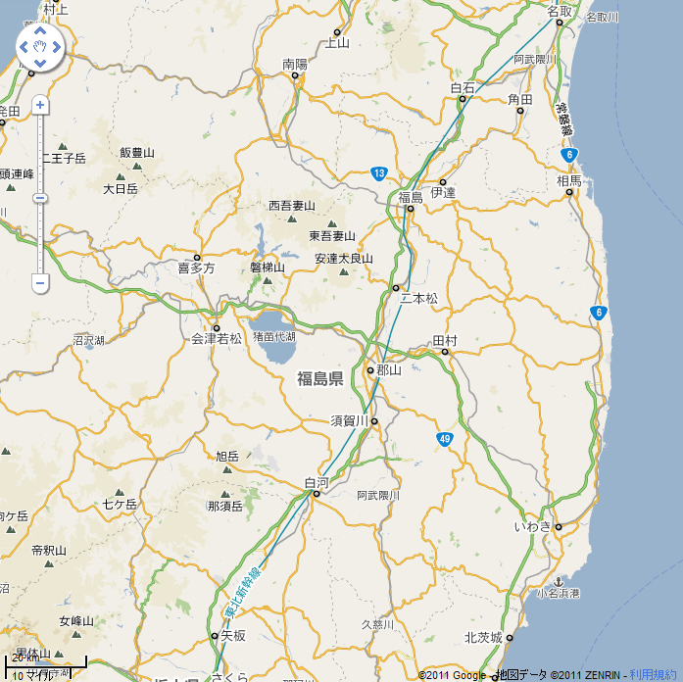
5
Radiological situation and corresponding protective actions
Precautionary urgent protective actions (evacuation, sheltering)
Urgent protective actions (foodstuff and water restrictions)
Early protective actions (preparation for temporary relocation)
Fukushima
Minami
Soma
Aizu Wakamatsu
Koriyama
1F NPP
20km
30km
Minami
Aizu
2F NPP
Shirakawa
Iwaki
Prolonged releases with multi-unit events
20km
Notes:
This shows the radiological situation at the accident.
In the area of the Fukushima Daiichi, the circulation of sea and land breezes is a predominant factor for dispersion of released radioactivity.
At night, the wind blows toward the sea.
In the early morning, it shifts to the south, and during the daytime wind direction changes clockwise.
This first peak on 12 of March was observed at Minami-soma about 20km north of the plant. This might be resulted from the releases at Unit 1.
The releases from Unit 3 during 13th were transported toward the sea.
The major release from Unit 2 was first observed at Iwaki in the morning on 15th. After that, in the afternoon, the plume reached the cities of Shirakawa, Koriyama and Fukushima and the airborne radiation levels rose.
In the evening, the entire prefecture of Fukushima experienced rain and snow, depositing the radioactivity on the ground during the plume passage.
The areas to the northwest of the plant were thus highly contaminated.
After this event, drinking water and food restrictions were taken first on March 21 and the consideration of temporary relocation outside the evacuation zone began.

Slide 4
Background
ICRP Publications 109 and 111 were issued in 2009 (23 years after the Chernobyl accident)
First Publications implementing the new Recommendations of the Commission (Publication 103, 2007)
When the Fukushima accident occurred no authority in the world had had the time to analyze and integrate the advice of Publications 109 and 111 in regulation. However they have been influential in the management of the accident but not always well understood and applied
Soon after the accident ICRP Task Group 84 was established to draw the ‘Initial Lessons from the NPP Accident in Japan vis-à-vis the ICRP System of Radiological Protection’
Released in November 2012, the Summary of the Task Group report highlighted several points requiring clarification and additions in Publications 109 and 111
4

Slide 5
Key issues in update of Publication 109
Timeline of situations and protective measures in emergency management
Justification of protective measures (more good than harm with taking into account non-radiological consequences)
Optimisation of protection strategies in emergency
  The ICRP concept of optimising whole protection strategies (i.e. response through to recovery/rehabilitation) is useful for planning purposes but very difficult to implement in practice.
  There is a need for more specific guidance on how to carry out optimisation following an accident.
  Reference levels and intervention levels
Lifting protective measures
Criteria for the transition from emergency to existing exposure situations
Environmental monitoring and health surveillance
Foodstuff and contaminated waste management
Radiation protection of responders

Slide 6
Key issues in update of Publication 111
Living in contaminated areas is an existing exposure situation
The protection strategy should do more good than harm
Implementation of protection strategy
  Protection actions implemented by authorities
  Self-help protection and radiation protection culture
Reference levels
Non-radiological aspects and human dimension
Engaging local stakeholders
Environmental monitoring and health surveillance
Foodstuff management
Radiation protection of recovery workers

Slide 7
ICRP Task Group on the update of Publications 109 and 111
Michiaki Kai, Japan (Chair)
Toshimitsu Homma, Japan (Vice-chair)
Anne Nisbet, UK
Thierry Schneider, France
Victor Averin, Belarus
Ralph Andersen, USA
Corresponding Members:
Miroslav Pinak (IAEA) Ted Lazo (NEA/CRPPH)
Collaboration with:
Fukushima dialogue stakeholders
ICRP members:
Jacques Lochard (MC), Chris Clement (Scientific Secretary),
Jean-François Lecomte (C4), Ohtsura Niwa (MC),
Nobuhiko Ban (C1)
7
Notes:
7

Slide 8
TG93 and related meetings held
TG93 meetings
1st 28-29, Nov, 2013 Fukushima
2nd 8-9, May, 2014 Fukushima
3rd 28-30, Nov. 2014 Paris
4th 30 Mar. – 1 Apr., 2015 Paris
5th 8-10, July, 2015 Tokyo
ICRP dialogue meetings
12 meetings during Nov. 2011 - Sep. 2015, Fukushima
Stakeholder meeting
6-7, July, 2015 Tokyo

Slide 9
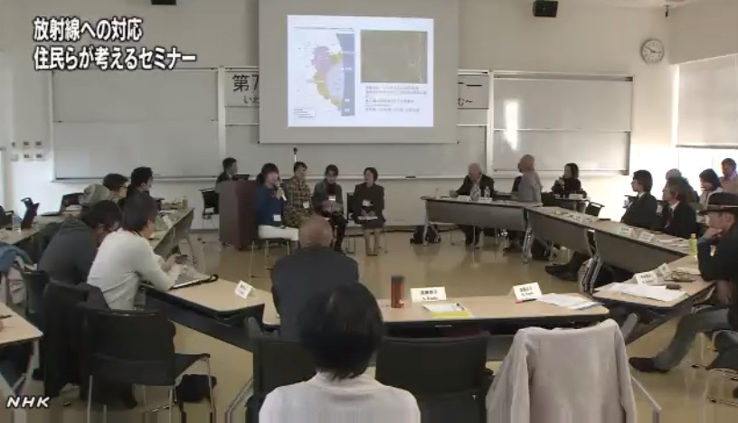
7th ICRP dialogue seminar in Iwaki – November 2013
9

Slide 10
Task Group 93 draft report
Application of the Commission’s Recommendations
for the protection of people in the event of a large nuclear accident
- Update of Publications 109 and 111 -
Contents
Editorial: From Chernobyl to Fukushima
Abstract
Preface
Main points/Executive summary
Glossary
1. INTRODUCTION
2. GENERAL CONSIDERATIONS
3. EMERGENCY
4. RECOVERY
5. CONCLUSION
ANNEX
A.1. Chernobyl
A.2. Fukushima
10

Slide 11
CONTENTS 1
1. INTRODUCTION
1.1. Background
1.2. Scope
1.3. Structure of the report
2. GENERAL CONSIDERATIONS
2.1. Accident timeline
2.2. Effects of nuclear accidents
2.2.1 Health effects
2.2.2 Societal effects
2.2.3 Environmental effects
2.3. Protection of people and the environment
2.3.1 Objective of the protection
2.3.2 Principle of justification
2.3.3 Principle of optimisation
2.3.3.1 Reference levels
2.4. Stakeholder involvement
2.5. Emergency and Recovery Preparedness
11

Slide 12
CONTENTS 2
3. EMERGENCY
3.1. Characteristics of the emergency phase
3.2. Protection strategies
3.3. Protection of the public
3.3.1 Radiological characterization
3.3.3.1 Environmental monitoring
3.3.3.2 Individual monitoring
3.3.2. Protective actions
3.3.2.1 Evacuation and relocation
3.3.2.2 Sheltering
3.3.2.3 Iodine thyroid blocking
3.3.2.4 Food
3.3.2.5 Decontamination of people
3.3.3. Termination of protective actions
3.4. Protection of emergency responders
3.5. Preparing for recovery
12

Slide 13
CONTENTS 3
4. RECOVERY
4.1. Characteristics of the recovery phase
4.2. Protection strategies
4.3. Protection of the public
4.3.1 Ongoing monitoring and surveillance
4.3.1.1 Radiation monitoring
Environmental monitoring
Individual monitoring
4.3.1.2 Health surveillance
4.3.2. Protective actions for the public
4.3.2.1 Foodstuff management
4.3.2.2 Remediation
4.3.2.3 Waste management
4.3.3. Co-expertise, radiological protection culture and self-help protection
4.4. Protection of recovery responders
4.5. Protection of the environment
4.6. Evolution and termination of protective actions
13

Slide 14

www.icrp.org
www.icrp.org

