Slide 1
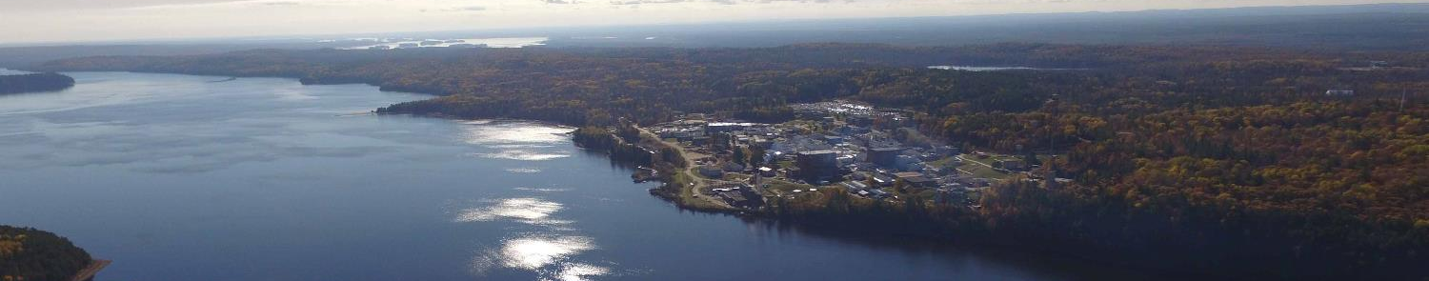
Linking Advanced Monitoring and Modeling in Nuclear Emergency Response Decision Support Systems
Luke Lebel, Vlad Korolevych, Lucian Ivan
NERIS Workshop, Roskilde Denmark, 2019 April
UNRESTRICTED / ILLIMITÉ
Notes:
Replace FST# and Project title with your own
Presented by: Add name, Project Lead or Technical Lead

Slide 2
ADVANCING EOC DECISION SUPPORT SYSTEMS
Program Outcomes
Assimilation Algorithms:
  Plume correction with radiological data
  Plume reconstruction from dose measurements
  Advanced meteorology
Monitoring Techniques:
  Real-time radionuclide monitor
  MCCI signatures analysis
  UAV flight path optimization
Decision Support Modules:
Visualization systems
Risk and consequence evaluation
informed
response
visualization
& mapping
source terms
radiological
EOC DSS
dispersion &
dose models
assimilation of
field data
dispersion
parameters
meteorological
UNRESTRICTED / ILLIMITÉ
Notes:
Please note: Limited to 1 slides max
Project introduction must include:
- Objective/purpose
- Linkages to government priorities and/or CNL Strategic Initiatives
- Federal stakeholders including the primary stakeholder

