Slide 1

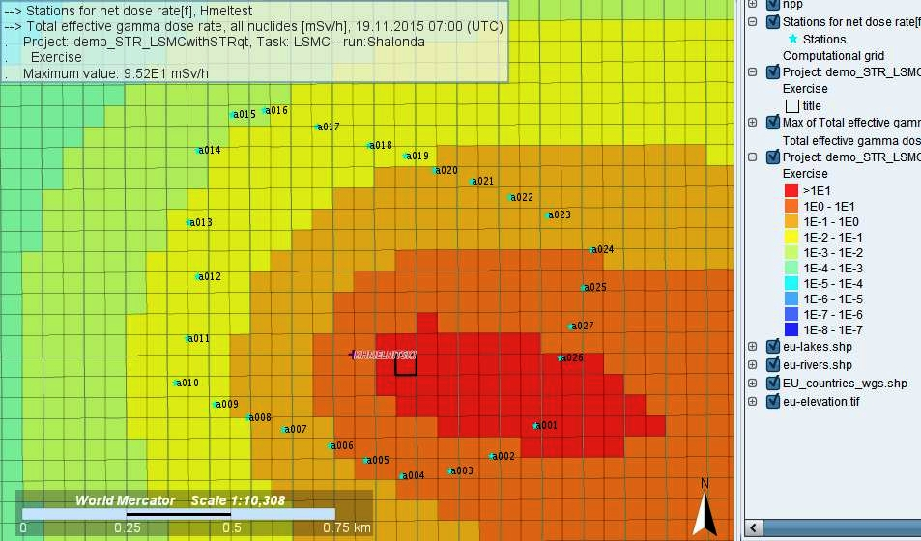
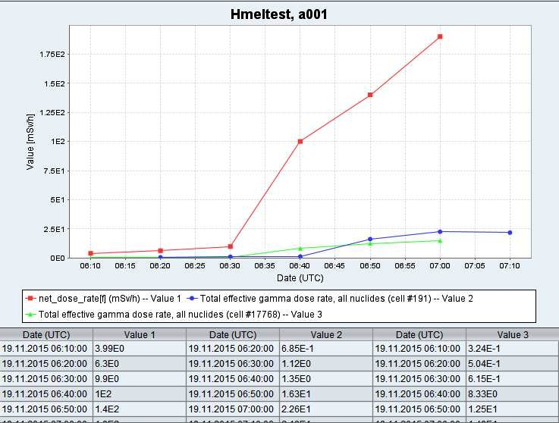
Source term reconstruction module in JRODOS
Wolfgang Raskob, Christoph Haller, Irmgard Hasemann, Thomas Schichtel, Dmytro Trybushnyi
Karlsruhe Institute of Technology (KIT)
NERIS Workshop 2019, 3-5 April, Roskilde, Denmark

Slide 2
Content
Introduction
Current implementation
Applications
Future ideas
Summary

Slide 3
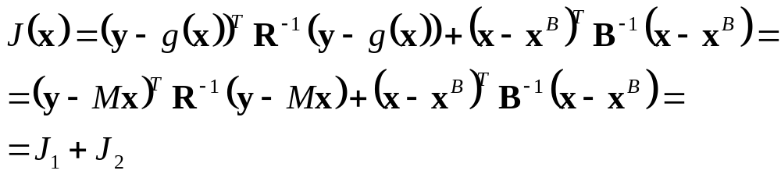
Basic principles and model application
General approach via cost function formulated on differences between:
  model predictions and measurements
  “first-guess” and estimated source term
The algorithm presented here in the following is based on a simple dispersion model and gamma dose rate measurements in the vicinity of the nuclear facility (VUJE)
Sequential algorithm performs estimation of the released inventory for each 10-min time step using the corresponding meteorological measurements and gamma dose rate measurements in the near vicinity at the fence (distances <800 m from the reactor building)

Slide 4
Input data
Real-time meteorological measurements from the NPP site (Npp meteostation):
  wind speed [m/s]
  wind direction [deg]
  stability category class [-]
  precipitation intensity [mm/h]
  date [dd.mm.yyyy] of measurement
  time [hh:mm] of measurement
Real-time gamma dose rate measurements in the vicinity of the site:
  dose rate [Sv/h] from all detectors (averaged over 10-minutes)
  date [dd.mm.yyyy] of measurement
  time [hh:mm] of measurement

Slide 5
Methodology
Based on the analyses of current data and data from the previous time step the module defines:
  How many detectors are affected by the release,
  Which detectors had been affected during the current time step (detector identification, its coordinates)
  Which detectors show errors or failures (too low or zero value or abnormally high value exceeding the detector sensitivity)
  The measured value of the affected detector should be greater than the background (if the detector was not affected in the previous time step)
Estimation of ST for each 10 minutes release
The simple method uses N linear algebraic equations (N = number of affected stations) for M unknown parameters (M = nuclides activities) for searching a possible solution
Number of stations limits the performance of the method!

Slide 6
Database of normalised dose rate
Normalized dose rates (from cloud and ground exposure) are calculated for different parameters:
  Release height (10 classes of height – maximal height 200 m)
  Initial width (radius) of the cloud (10 classes of width – influence of reactor building cavity)
  Stability class (6 classes)
  Wind speed (10 classes)
  Intensity of precipitation (10 classes)
Dose rate is calculated for 10 representative nuclides

Slide 7
Database of normalised dose rate (cont.)
Radionuclide group | Radionuclide group representative
1 – Noble Gasses | ¹³³Xe
2 – Alkali Metals | ¹³⁶Cs
3 – Alkaline Earths | ¹⁴⁰Ba
4 – Halogens | ¹³¹I
5 – Chalcogens | ¹³²Te
6 – Platinoids | ¹⁰³Ru
7 – Early Transition Elements | ⁹⁹Mo
8 - Tetravalents | ¹⁴³Ce
9 – Trivalents | ¹⁴⁰La
10 – More Volatile Main Group | ¹²⁷Sb
MELCOR groups and representative radionuclide

Slide 8
Output
The methodology searches activities for N nuclides, which provide a dose rate closest to real measurements (searching of the minimal square of the different between measurements and calculate values)
Proper representation of the nuclide vector is also critical
The quality of results depends on the number of measurements taken into consideration – the more measurements the less uncertain is the source term estimate
As final result, a source term with the representative nuclides is provided that can be used in further calculations

Slide 9
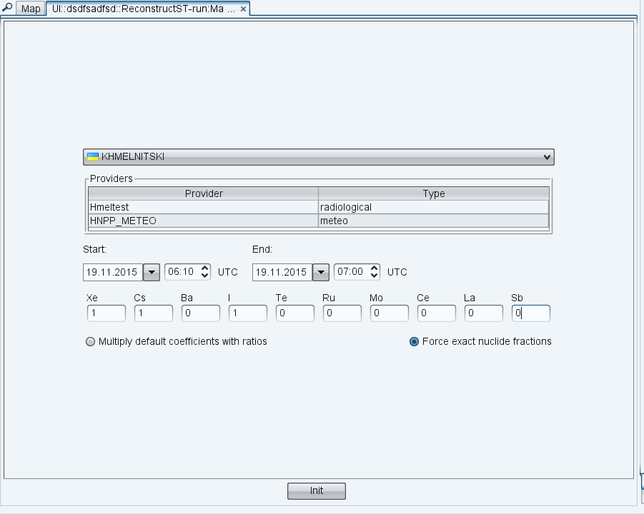
Ongoing work
The original method uses no information on the possible release and estimates the source term fully based on the incoming GDR and data base information
KIT has developed a further method that considers the information on a possible nuclide vector
displayed in the input
window with selection
of nuclide groups and
method

Slide 10
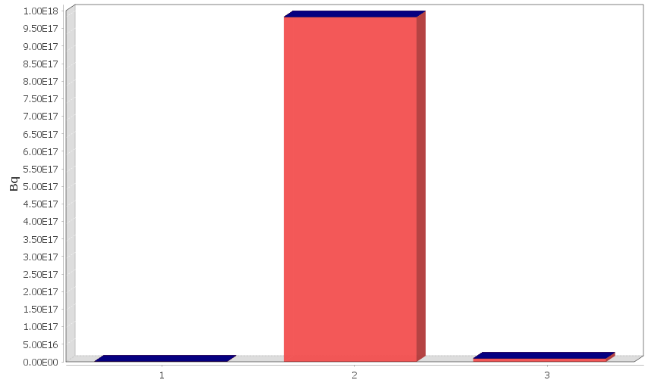
Release of Xe-133 only
Time Amount
0.00 - 0.17 1.00E+15
0.17 - 0.34 0
0.34 - 0.50 0
0.50 - 0.67 0
0.67 - 0.84 0
0.84 - 1.00 0
1.00 - 1.17 0
1.17 - 1.35 1.00E+18
1.34 - 0.50 0
1.50 - 0.67 0
1.67 - 0.84 0
1.84 - 2.00 0
2.00 - 1.17 0
2.17 - 2.34 0
2.34 - 2.50 1.00E+16
Linear representation of source term

Slide 11
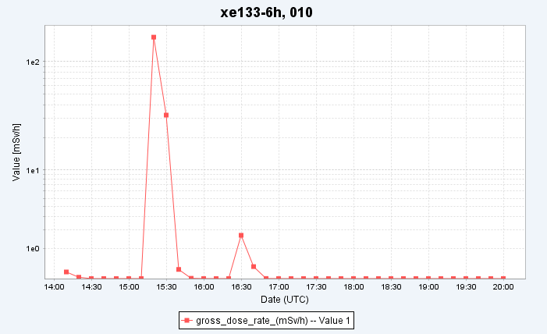
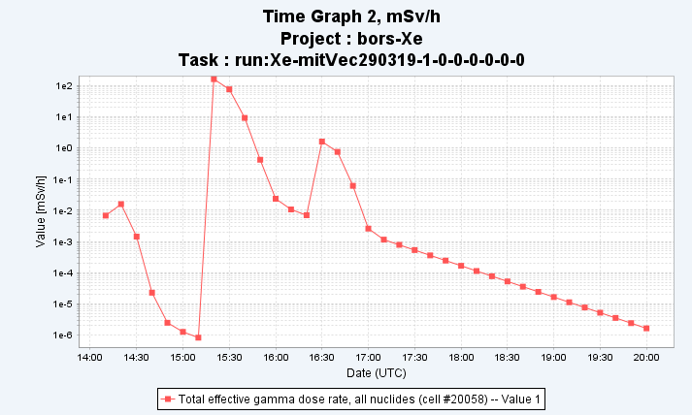
Results
Original gamma dose
rate
Reconstructed gamma dose rate

Slide 12
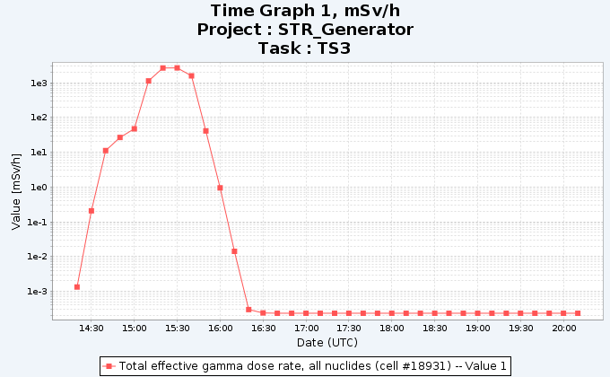
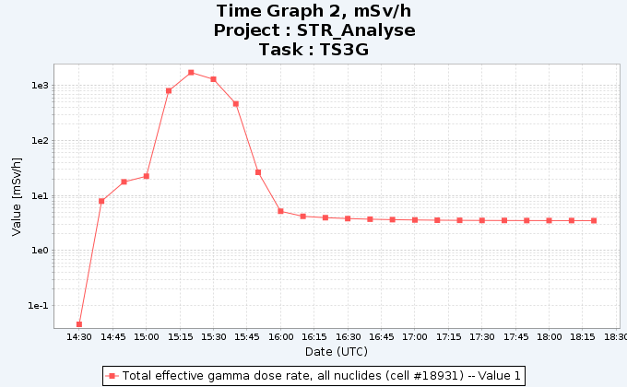
Simple scenario
Site Borssele/Netherlands, Source term: 10m-release
0h – 0.5h : 10¹⁶Bq Xe133 , 2.0·10¹⁶Bq Cs-137
0.5h – 1.0h : 10¹⁸Bq Xe133 , 2.0·10¹⁸Bq Cs-137
meteo: stable weather conditions, low wind, prognosis period: 6 hours
Original GDR simulation Reconstructed GDR

Slide 13
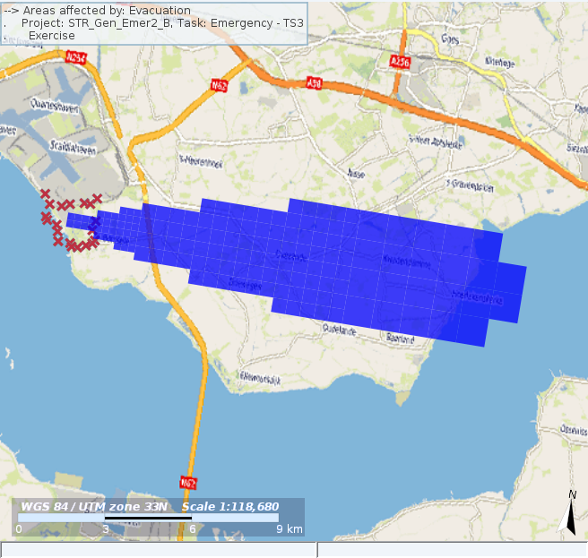
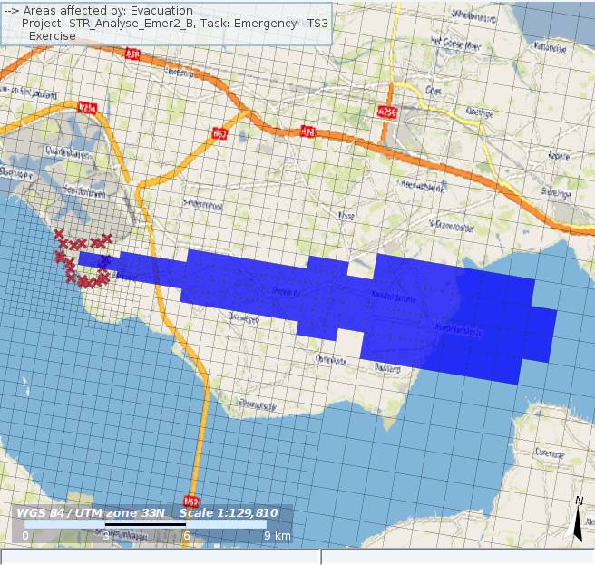
Evacuation area for example
Original
Reconstructed

Slide 14
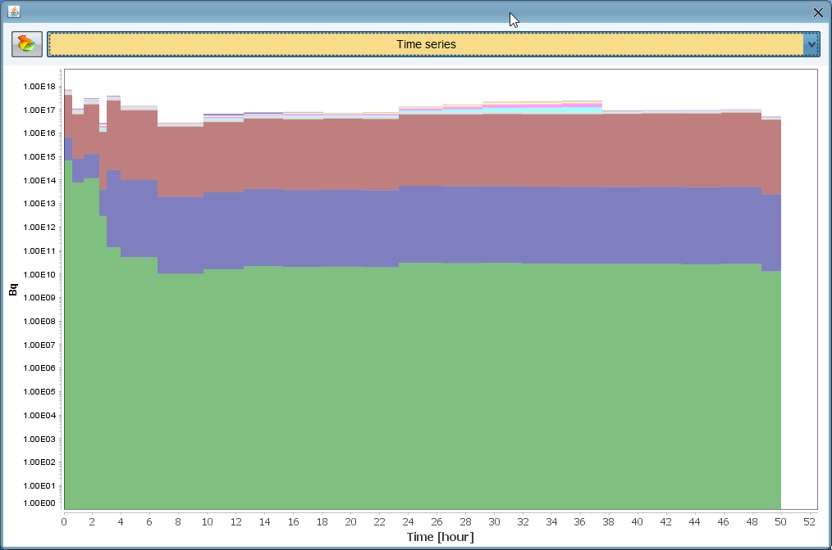
Complex source term, simple weather
50 hours, about 10% of aerosls and nearly all noble gases

Slide 15
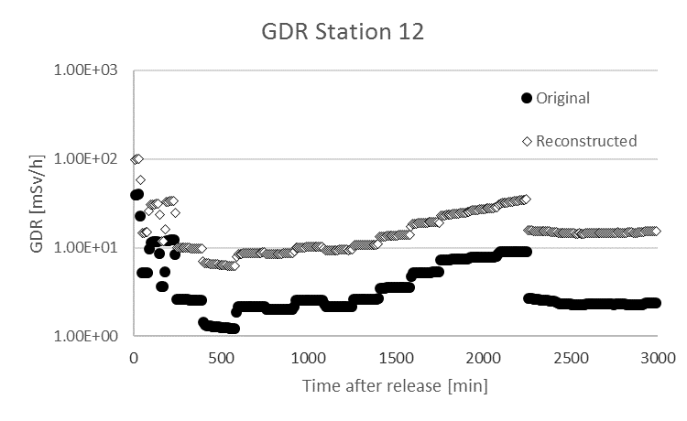
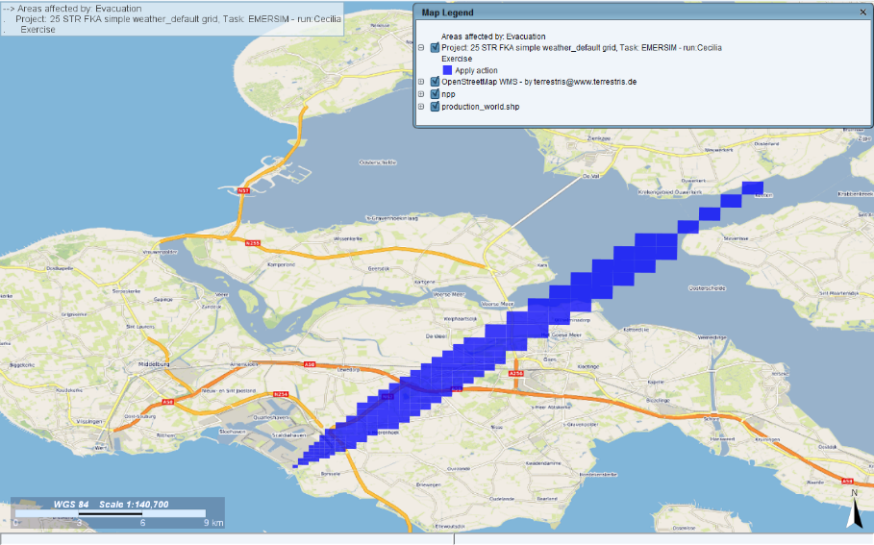

Results with original method
Original evacuation reconstructed evacuation

Slide 16
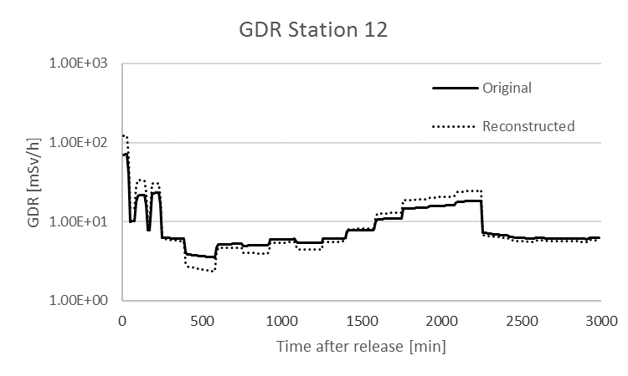
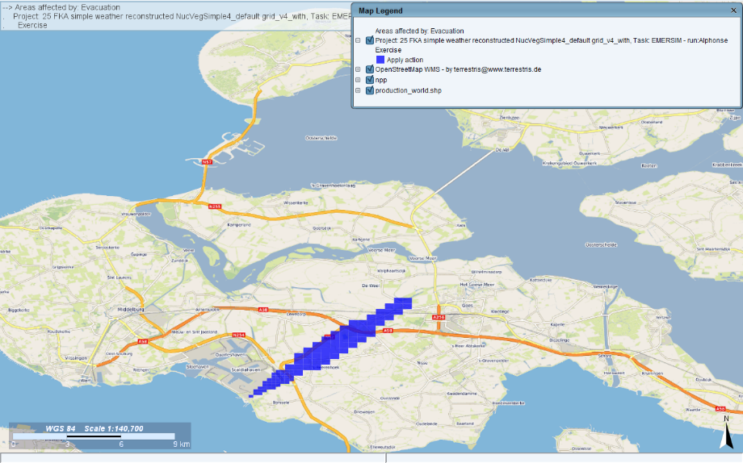
New method with nuclide vector
Original evacuation reconstructed evacuation

Slide 17
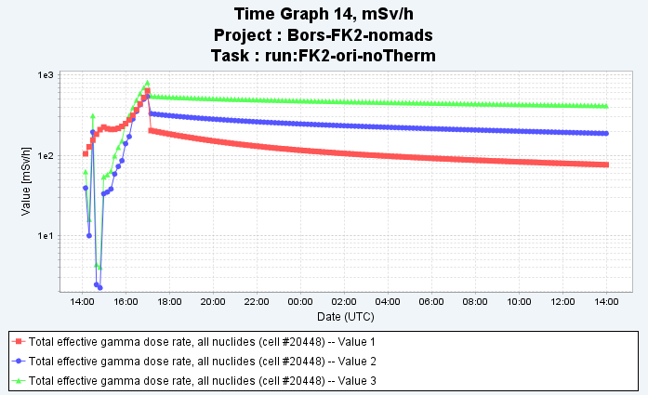
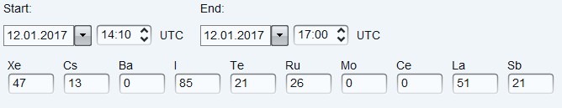
Short term (3h) release with numerical weather
Dose rate in the vicinity of the release location
Red = original data
Reconstructed ST, with UserVectorFile, weighted
Reconstructed ST, with UserVectorFile, equally weighted;

Slide 18
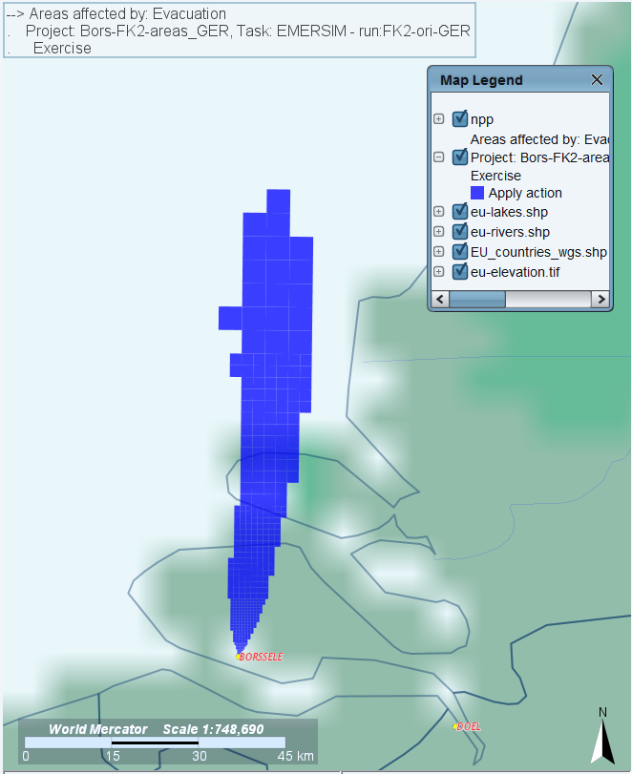
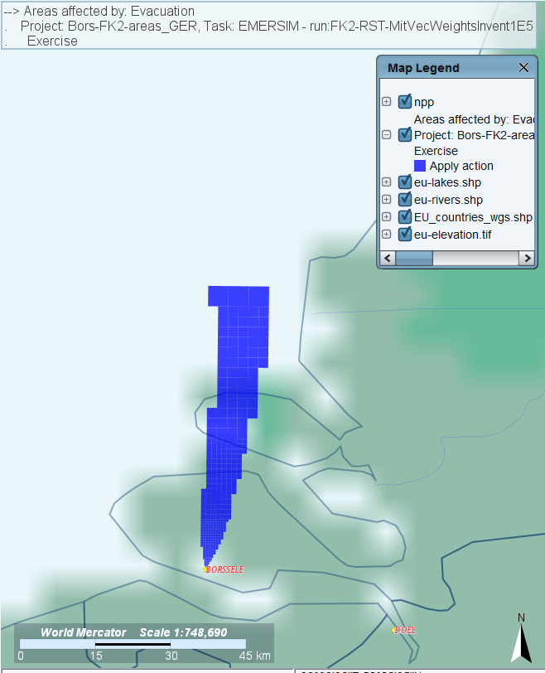
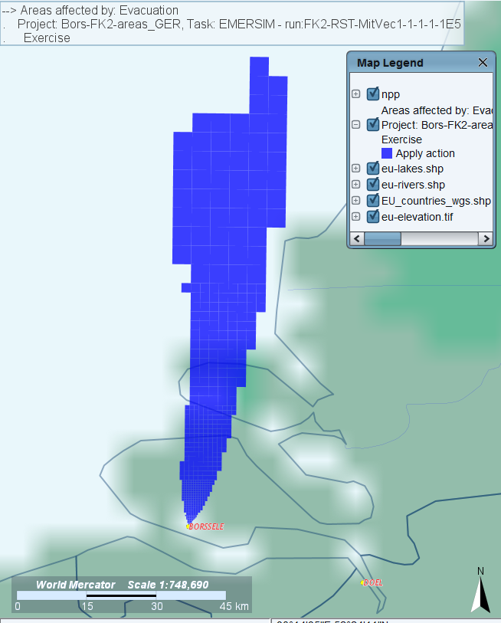
Short term (3h) release with numerical weather
Original evacuation area Weighted with inventory Equally weighted

Slide 19
Conclusions
The simple source term reconstruction module uses pre-defined databases and monitoring information to estimate a source term
Positive aspects
  No a priori source term needed
  Easy to apply, fast calculation
  Good results for simple scenarios
Improvements needed
  Assure that the nuclide mix is reconstructed in a proper way if the number of monitoring stations is limited – a priory nuclide vector based on inventory
  Further tests of numerical methods
Drawbacks
  Stations have to be close to the site
  Number of stations not too small
Report on this as part of FASTNET and included in next JRODOS

Slide 20
  Thank you for your attention!
  Questions?
  https://resy5.iket.kit.edu

