Slide 1
Formal and informal participation in Emergency Preparedness and Response
A purposeful mapping exercise
M. Van Oudheusden, C. Turcanu, B.Abelshausen
SCK•CEN, Belgian Nuclear Research Centre
cturcanu@sckcen.be
NERIS Workshop 3-5 April 2019, Roskilde, Denmark

Slide 2
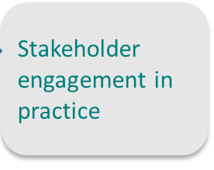
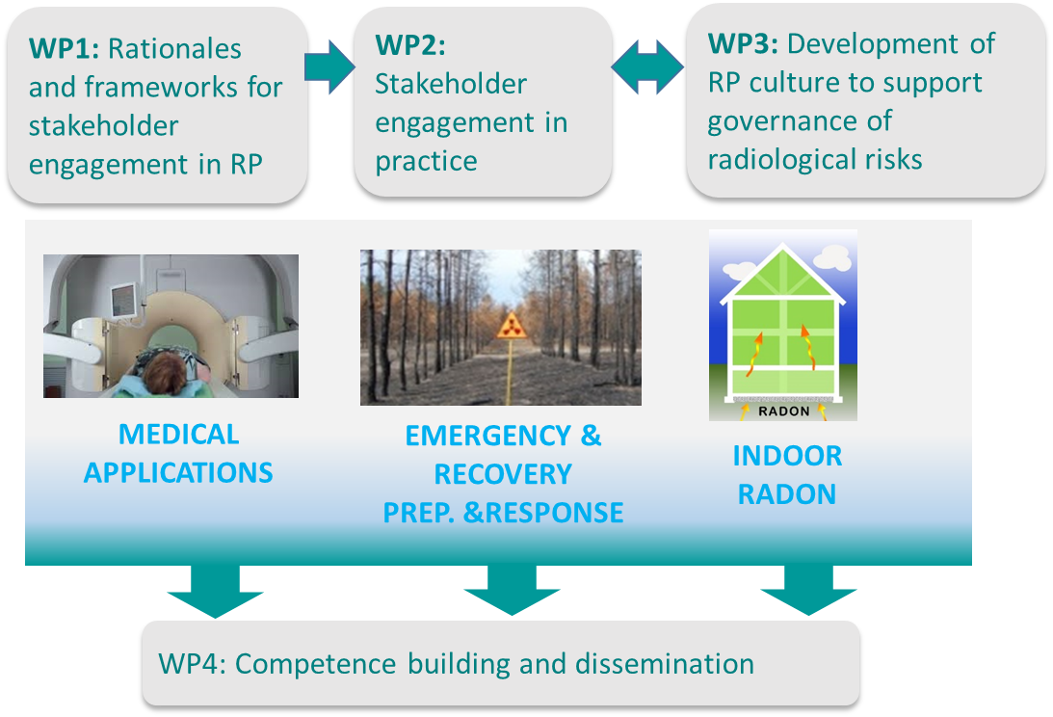
ENGAGE project

Slide 3
Guiding research questions
How is stakeholder engagement understood and practiced?
What were the rationales for engagement?
What forms of acceptance or resistance do we encounter?
Are there any alignments/misalignments between practice and external conceptions and prescriptions, and if so why?
Which challenges and opportunities do we encounter in specific cases?
What are the benefits of stakeholder participation processes?
What are radiation protection actors and communities doing that may de facto count as stakeholder engagement (but is not necessarily labelled that way)?

Slide 4
Challenges and opportunities (examples)
Low awareness in the preparedness phase;
No mechanisms for stakeholder engagement and no operational networks;
Low involvement of non-institutional stakeholders and local populations;
Sustainability of stakeholder networks;
Lack of capacities among local actors;
Mismatch of expectations
Change of paradigm: working with local communities instead of planning for them;
Revision of BSS
Previous research (e.g. radwaste)
  → e.g. bottom-up definition of ‘affected community’.
Good practices in some countries
Institutional and non-institutional participation (e.g. citizen science) in EPR or connected fields
Lessons learned from past accidents
ENGAGE Deliverable D 9.82

Slide 5
Stakeholder engagement practices in
EU Member States
(survey with national regulatory authorities)
Data collected through a questionnaire in the context of a broader study supported by DG energy in 28 EU MS (26 MS responded). December 2017 to May 2018

Slide 6
What are radiation protection actors and communities doing that may de facto count as participation in emergency preparedness and response (but is not necessarily labelled that way)?
Mapping formal and informal participation

Slide 7

101 ways to sample
extreme / deviant case sampling
intensity sampling
maximum variation sampling
homogeneous sample
typical case sampling
critical case sampling
snowball case sampling
criterion sampling
opportunistic sampling
purposeful random sampling
sampling politically important cases
…

Slide 8
What else is there?
methodologically inclusive research synthesis (MIRS)
qualitative, interpretive
descriptive, informative, evaluative, and connective
  “… to produce new knowledge by making explicit connections and tensions between individual study reports that were not visible before”
identify “the cracks, or the gaps, in a field rather than producing a meta-narrative”
selecting information-rich cases for study in depth
focus on how results can be useful to stakeholders

Slide 9
Data collection
Online resources (Google search, last 10 years)
Academic and grey literature (Google Scholar search)
  (nuclear emergency OR nuclear accident OR radioactivity) AND (participation OR panel OR debate OR meeting OR workshop OR action OR protest OR network) AND (stakeholder OR citizen) AND (Belgium)
Other sources
  e.g. referrals by other actors, research projects
Rigor
-sufficient data
-triangulation
-making transparent
what are we missing?

Slide 10
Database with different cases
Most frequent
Public information provided by federal emergency actors or local communities to the general public or particular groups: websites, campaigns, leaflets, platforms (BE-alert)
Emergency exercises federal, regional and local emergency management actors
Questions in Parliament by MPs
Actions by NGO’s (notably Greenpeace): protests, scientific studies, questions in Parliament, law suits
Research initiatives: stakeholder panels (emergency management actors and other stakeholders), surveys (general and specific publics)

Slide 11
Database with different cases
Rare
Two-way communication: Facebook live sessions organized by Crisis Centre, personalized emergency plan
Actions initiated by CVO’s: workshop and working group on emergency planning of the partnership for radioactive waste disposal in Mol;
Feedback on emergency plans from local actors, CVO’s, NGO’s and publics: revision of emergency plan cf. BSS, focus group at school near Tihange, lessons learned from emergency planning by and for local mayors
Broader participation in emergency exercises: volunteers

Slide 12
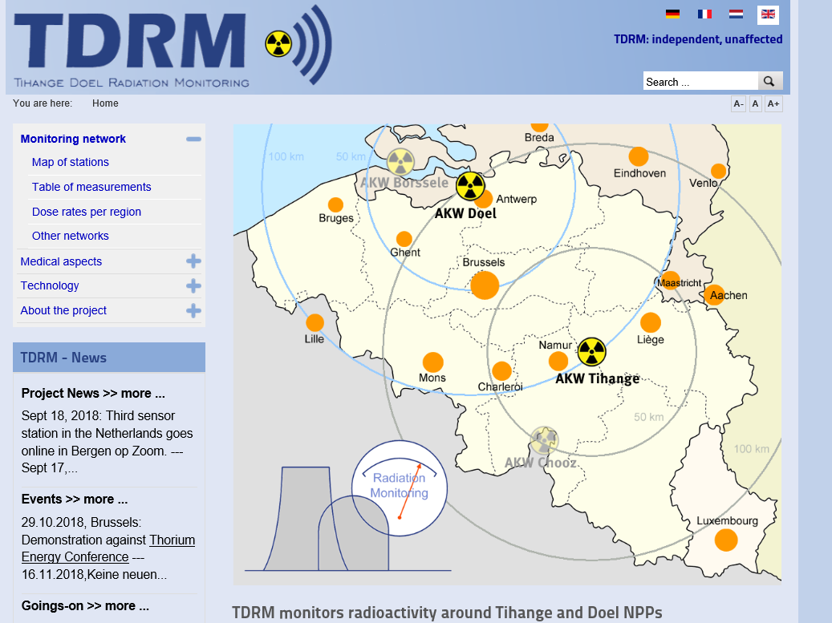
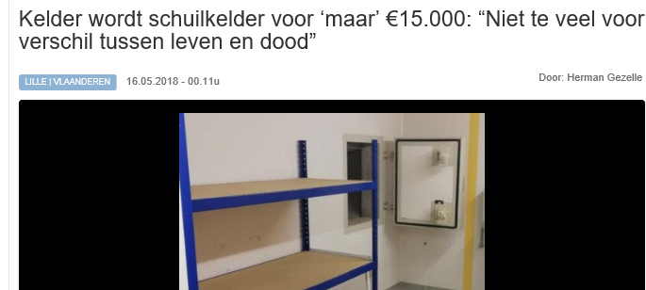
Database with different cases
“Exotic”
Citizens’ measuring networks
Commodification of safety

Slide 13
Different patterns of interaction (1)
Government
Academia
E.g. expert advice on lessons learned after Fukushima
E.g. questions in Parliament
Business
Civil society
E.g. citizen science, protests, studies
E.g. bunker

Slide 14
Different patterns of interaction (2)
Government
Academia (RP, SSH,…)
Business
Civil society

Slide 15
Continuous vs. discontinuous
Reduce nuclear risk EPR plans (Preparedness for) (Preparedness for) Emergency Post-accident
management management
Regulatory authorities
Nuclear installations
NGO’s
Action groups
Citizens
Governmental emergency actors
Installations
Research organisations
NGO’s
CVO’s
citizens
Governmental emergency actors
Research organisations
Installations
Citizen scientists
Local stakeholders
Research organisations
Governmental emergency actors
Industry, agriculture, etc
NGO’s
CVO’s
Continuous vs. discontinuous

Slide 16
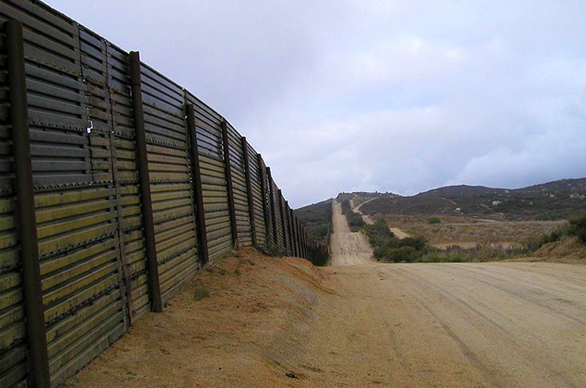
What kinds of participation are enacted? (broad)
Who is involved in participation? (narrow)
What/who is out? (broad)
core
periphery

Slide 17
Broad range of participatory practices potentially shaping radiation protection
Participation in radiological risk governance as performative practice
Who
Why
What
How

