Slide 1
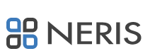


5th NERIS Workshop
OPTIMIZATION OF THE FOOD CHAIN AND DOSE MODULE FOR TERRESTRIAL PATHWAYS (FDMT) APPLIED TO PORTUGAL
Catarina Inácio⁽¹⁾, Paulo Marques Nunes⁽²⁾, David Ferreira⁽¹⁾, Filipa Jerónimo⁽¹⁾, Márcia Farto⁽²⁾, Luís Portugal⁽²⁾, Mário Reis⁽¹⁾, João Oliveira Martins⁽²⁾,
⁽¹⁾ Instituto Superior Técnico, Lisboa, catarinainacio95@gmail.com
⁽²⁾ Agência Portuguesa do Ambiente (Portuguese Environment Agency), Amadora

Slide 2
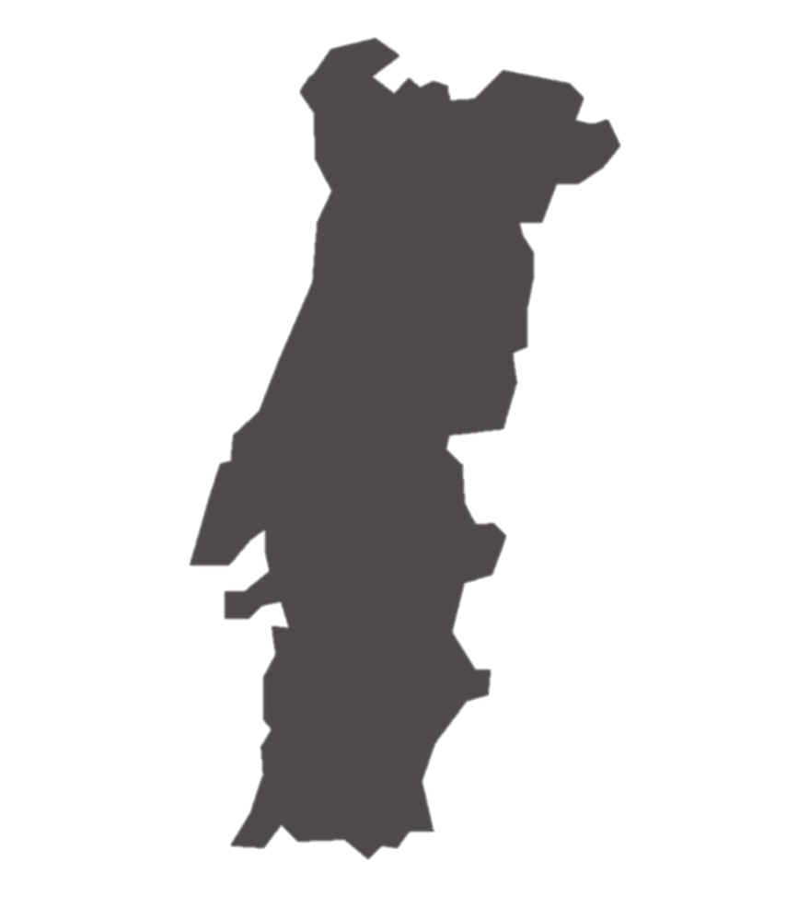
OPTIMIZATION OF THE FOOD CHAIN AND DOSE MODULE FOR TERRESTRIAL PATHWAYS (FDMT) APPLIED TO PORTUGAL
This work represents part of the Master’s thesis of Catarina Inácio on Radiological Safety and Protection
INTRODUCTION
The Chernobyl accident demonstrated deficiencies regarding the radiation protection requisites.
Due to that, it was created the Real-time Online DecisiOn Support system, JRODOS.
Default diet data
Central Europe
Need to optimize FDMT model for South Europe diet
OBJECTIVE
Adaptation of JRODOS FDMT model to the Portuguese case considering a Mediterranean diet and the most consumed and exported foodstuffs.

Slide 3
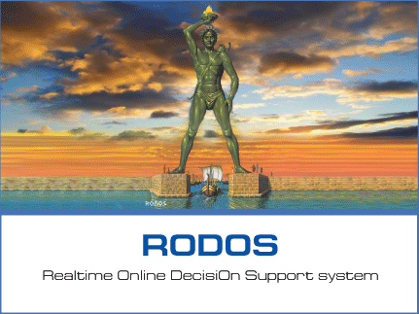



OPTIMIZATION OF THE FOOD CHAIN AND DOSE MODULE FOR TERRESTRIAL PATHWAYS (FDMT) APPLIED TO PORTUGAL
METHODOLOGY
FDMT Model
Intervention Levels
Simulates the transfer of radionuclides and exposure in food chains and evaluates the dose by the relevant pathways
Harm caused by banning the consumption of food
Benefit caused by allowing the consumption of food
Provides information during all phases and prepare for a future event
EXPECTED RESULTS
Olives (olive oil) and grapes (wine) have a high consume rate and they are not considered in the model.
Reducing human exposure due to food consumption
Optimization of the model will contribute to the radiological protection and nuclear safety
Help to mitigate the consequences

Slide 4
5th NERIS Workshop
THANK YOU

