Slide 1


Sources of uncertainty in the ERMIN urban dose model
Tom Charnock
NERIS Workshop Roskilde 2019

Slide 2
Preamble
CONFIDENCE Project
CONFIDENCE: uncertainties in the area of emergency management and long term rehabilitation following a nuclear accident
WP4: stakeholder engagement transition to long term recovery
Looking at sources of uncertainty in the ERMIN model
residual doses in urban environments with/without clean-up options
CONFIDENCE deliverable “D 9.20 - Addressing the uncertainties in urban/inhabited scenarios”
Appendix 1:Urban Scenario Parameter Uncertainty, Kasper Andersson
Appendix 2: ERMIN uncertainty, Tom Charnock
Objectives
understand/guide appropriate use of ERMIN,
to make quantitative/qualitative statements about uncertainties in ERMIN.
understand weakness and make recommendations for future developments
generate illustrative uncertainties of residual dose for WP4 stakeholder panels scenarios

Slide 3
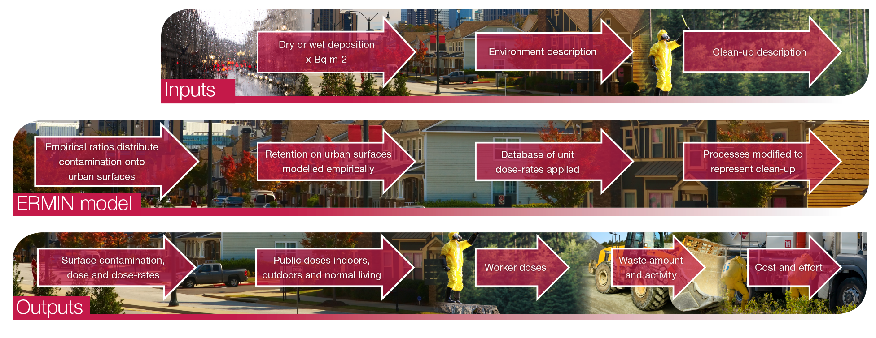
ERMIN model
ERMIN has been implemented in both ARGOS and RODOS Decision support systems
Charnock TW, Landman C, Trybushnyi D and Ievdin I (2016). European model for inhabited areas - ERMIN 2. Radioprotection 51(HSI), S23-S25

Slide 4
Types of uncertainty
Stochastic (related to physical randomness)
e.g. relative deposition to different surface, weathering rates, occupancy
Judgemental (choice of parameters)
e.g. choice of appropriate ‘representative’ value for deposition, weathering etc
Epistemological (lack of knowledge)
e.g. type of environment, degree of paving etc, countermeasure timing
Computational (coding on specific hardware)
e.g. grid size, temporal steps, numerical integration etc
Model uncertainty (simplification from the real world)
e.g choice of urban surfaces, continuous empirical retention functions
Ambiguity (lack of clarity and endpoint uncertainty)
e.g. occupancy weighting scheme to produce normal living dose, ‘other’ paved surface?
Parameter
uncertainty

Slide 5
Parameter uncertainty
Projected normal living residual doses
Restricted to ¹³⁷Cs deposited as soluble aerosol, assuming 10⁶ Bq.m⁻² deposited on reference surface.
Sensitivity and uncertainty analysis considering:
Occupancies
Redistribution of initial deposition on to urban sources.
Weathering
Soil migration
For several different environments, wet and dry deposition conditions, without and with various countermeasures applied.

Slide 6
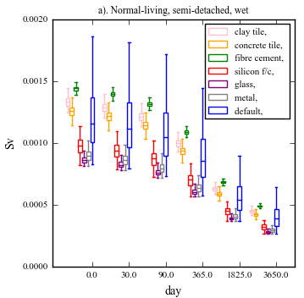
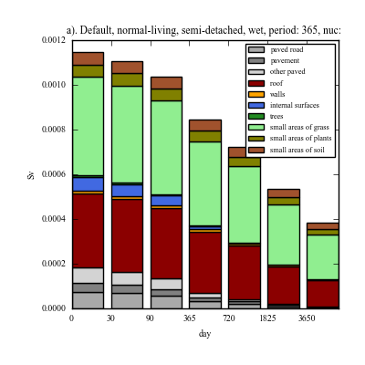
Initial roof deposition
Benchmark run: normal living dose annual dose, semi-detached house, wet deposition, predicted by surface using current ERMIN default parameters,
Sensitivity analysis: current ERMIN default parameters except for initial deposition on roofs.
Parameters for roofs sampled from distributions provided by Andersson (2018) for different materials.
Repeated for different environments and wet/dry
[Dose are integrated over 1 year from the time shown]

Slide 7
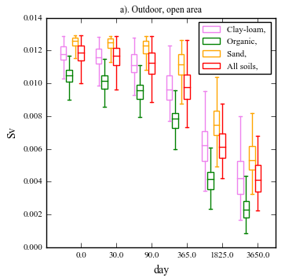
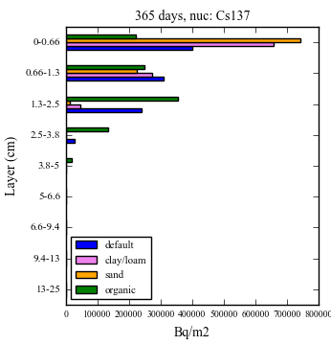
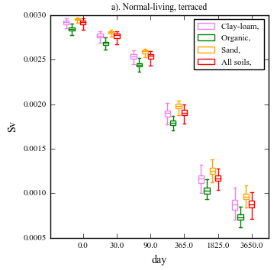
Soil migration
Sensitivity analysis:
Soil migration parameters for soil types sampled from distributions provided by Andersson (2018).
[Dose are integrated over 1 year from the time shown]
Profiles of total activity (Bq m⁻²) in the soil column after one year. ERMIN default parameters and average parameters for three soil types

Slide 8
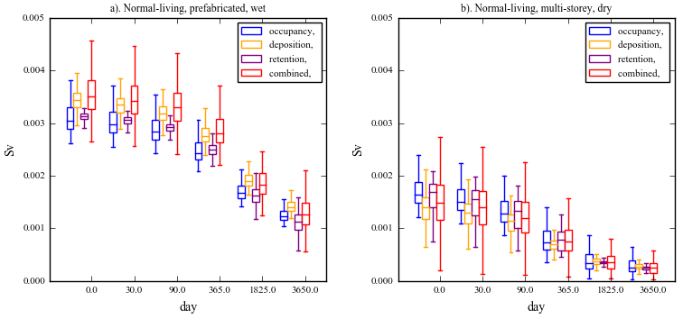
Combined uncertainty
Uncertainty analysis: sampling distributions of groups of parameters:
Occupancy (EXPOLIS)
Initial deposition ratios
Surface retention
Combined
[Dose are integrated over 1 year from the time shown]

Slide 9
Conclusions
Potential ERMIN model improvements:
Incorporating soil/nuclide/particle specific soil migration parameters
Incorporating different roof materials
Increase range of environments types and subtypes in database (more built-up environments)
Improving the indoor deposition model/parameters
Incorporation of uncertainty analysis in an operational ERMIN?
How to present/communicate uncertainty, consistency across all tools in DSS, within a mapping framework
Recommendations balance model/parameter improvement with ensuring ERMIN is operational (runtimes short, input available, output usable)
CONFIDENCE deliverable “D 9.20 - Addressing the uncertainties in urban/inhabited scenarios”

