Slide 1
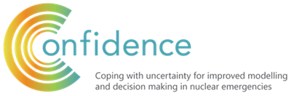
Agent-based Negotiation Simulation
Shan Bai, Wolfgang Raskob
Karlsruhe Institute of Technology (KIT)
NERIS Workshop 2019, 3-5 April, Roskilde, Denmark

Slide 2
Agent-based Negotiation Simulation
Strategy 3
Knowledge Database
Rankings
Strategy 2
Strategy xxx
Strategy xxx
...
Strategy 1
Agent 4
Agent 6
Agent 2
Agent 1
Agent 3
Agent 5

Slide 3
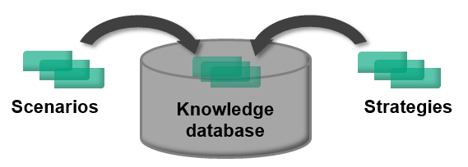
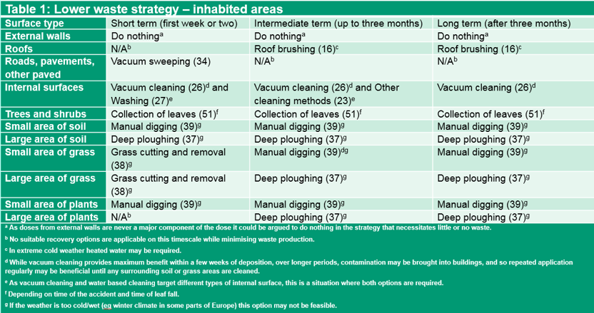

Knowledge Database & Strategies
Knowledge database
  Baseline scenarios
  Generic strategies
Strategies are developed for inhabited areas and food production systems.

Slide 4
Agent
Preference values of agents
Expert
Effective | Cost | Acceptance | Resouces needed
9 | 10 | 9 | 10
9 | 10 | 10 | 10
9 | 10 | 10 | 9
9 | 9 | 9 | 10
9 | 10 | 9 | 9
6 | 8 | 5 | 8
5 | 7 | 5 | 7
6 | 7 | 6 | 7
5 | 8 | 5 | 7
6 | 7 | 6 | 7
2 | 2 | 3 | 2
2 | 3 | 3 | 2
2 | 3 | 2 | 3
3 | 2 | 3 | 3
2 | 3 | 3 | 2
4 | 2 | 3 | 1
3 | 2 | 2 | 1
3 | 1 | 3 | 1
3 | 1 | 3 | 2
4 | 2 | 3 | 2
1 | 7 | 8 | 3
1 | 6 | 8 | 3
2 | 7 | 7 | 2
1 | 6 | 7 | 2
2 | 7 | 8 | 2
Politician
Agent groups
Agents
Lawyer
NGO
Industry/consumers

Slide 5
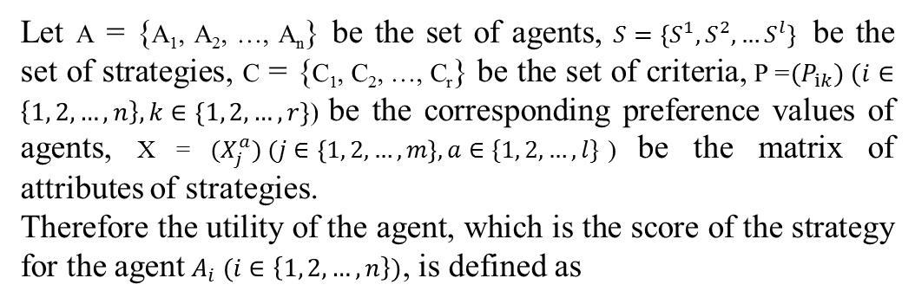
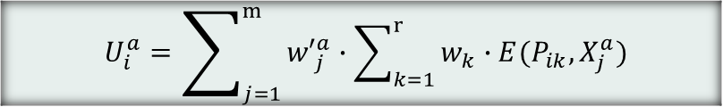
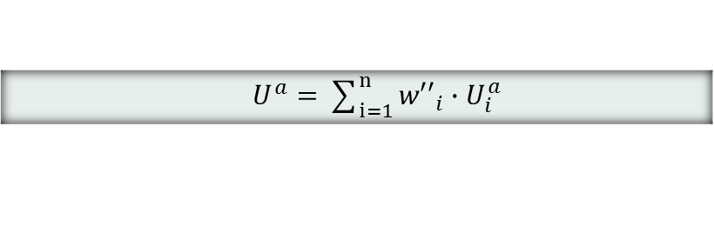
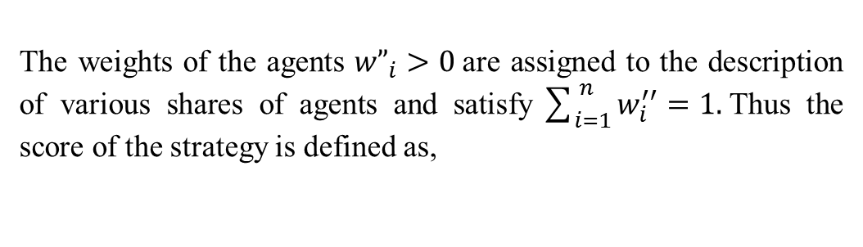
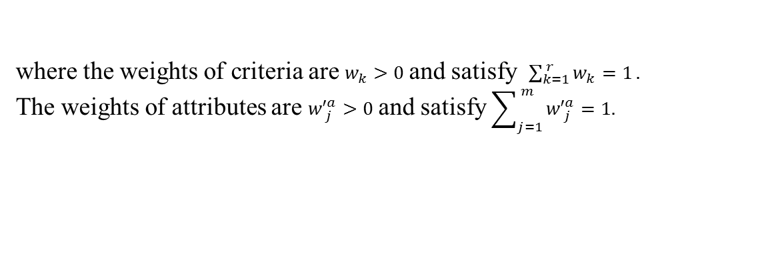
Evaluation
Let A = {A₁, A₂, …, A_{n}} be the set of agents, $S=\left\{S^{1},S^{2},…S^{l}\right\}$ be the set of strategies, C = {C₁, C₂, …, C_{r}} be the set of criteria, P = ${(P}_{ik}) (i∈\left\{1, 2, …, n\right\}, k∈\{1, 2, …, r\}$) be the corresponding preference values of agents, X = $(X_{j}^{a}) (j∈\left\{1, 2, …, m\right\}, a∈\{1, 2, …, l\}$) be the matrix of attributes of strategies.
Therefore the utility of the agent, which is the score of the strategy for the agent$A_{i} (i∈\left\{1, 2, …, n\right\})$, is defined as
$U_{i}^{a}=\sum_{j=1}^{m}{{w′}_{j}^{a}∙\sum_{k=1}^{r}{w_{k}∙{E(P}_{ik},X_{j}^{a})} }$
where the weights of criteria are $w_{k}>0$and satisfy $\sum_{k=1}^{ r}{w_{k}=1}.$
The weights of attributes are ${w′}_{j}^{a}>0$and satisfy $\sum_{j=1}^{ m}{{w′}_{j}^{a}=1. }$
The weights of the agents ${w”}_{i}>0$are assigned to the description of various shares of agents and satisfy$\sum_{i=1}^{ n}{w_{i}^{′′}}=1.$Thus the score of the strategy is defined as,
$U^{a}=\sum_{i=1}^{n}{{w′′}_{i}∙U_{i}^{a}}$

Slide 6
Negotiation Process
Negotiation framework
  The agents involved in negotiation
  The conflict objects (issues in negotiation) – Protection strategies
  The public rules of interaction – Protocol, Negotiation strategies
  The strategic resolution decision – Cut-down mechanism

Slide 7
Negotiation Process – Protocol
Protocol contains
  the permissible content of interactions which agents exchange with one another.
  the permissible process of interactions; when and how to exchange contents.
Agent 1
Agent 3
Agent 2

Slide 8
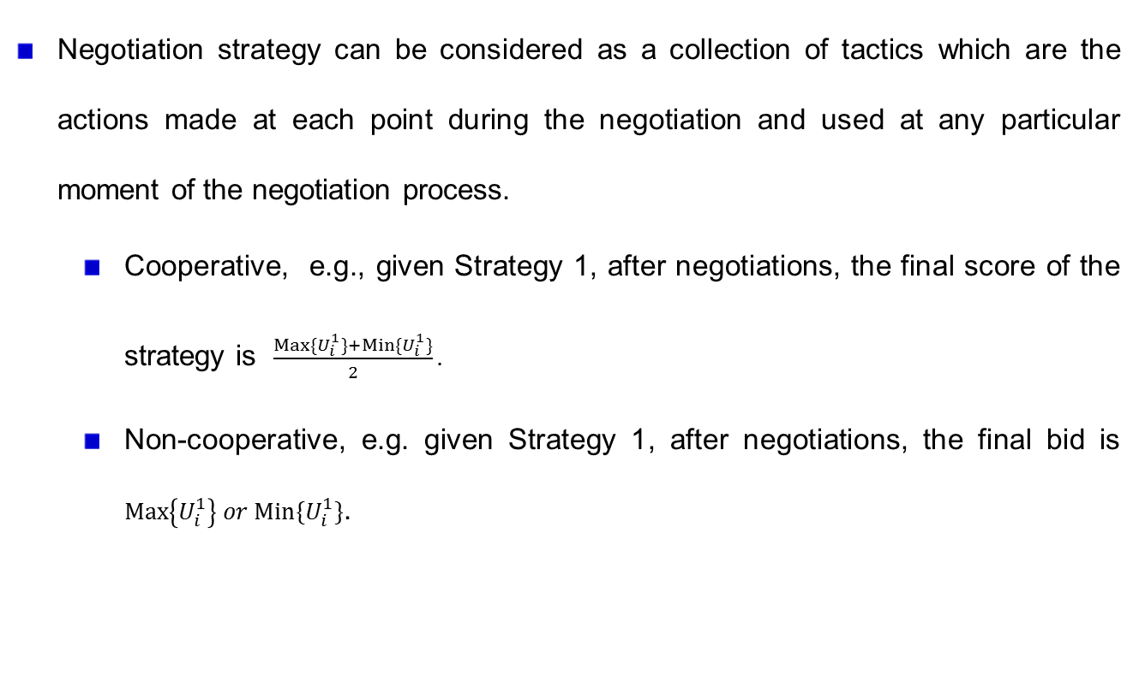
Negotiation Process - Negotiation Strategy
Negotiation strategy can be considered as a collection of tactics which are the actions made at each point during the negotiation and used at any particular moment of the negotiation process.
  Cooperative, e.g., given Strategy 1, after negotiations, the final score of the strategy is $\frac{Max\{U_{i}^{1}\}+Min\{U_{i}^{1}\}}{2}.$
  Non-cooperative, e.g. given Strategy 1, after negotiations, the final bid is $Max\left\{U_{i}^{1}\right\} or Min\{U_{i}^{1}\}$.
Agent 1
Agent 2
Agent 1
Agent 2

Slide 9
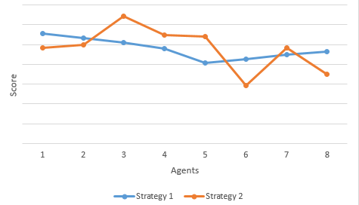
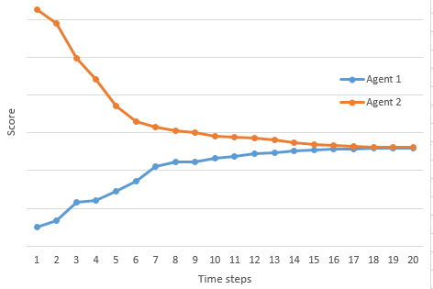
Negotiation Process – Cut-down mechanism
Two indices:
  The ranking of strategies
  The rate of the convergence of the score of strategy
Optimal situation:
  All agents get the same ranking after enough negotiation turns
Cutting down the process if
  the score of strategy is already convergent, or
  the time steps are big enough.
Compensation method if the negotiation is not successful.

Slide 10
Negotiation Process - Example
Phenomenon:
  3 Strategies
  2 Agents randomly selected from 2 fixed groups in negotiation.
Input: Scores of strategies on each agent (Gaussian process).

Slide 11
Negotiation Process - Example
Protocol
  All agents in the social network can exchange information about the strategies with each other without any restriction. In one iteration of negotiation, one agent talks with the others one time and adjusts its own opinion afterwards according to the aggregation of the opinions from the others.
Random Tit-for-Tat negotiation strategy (Faratin et. al.).

Slide 12
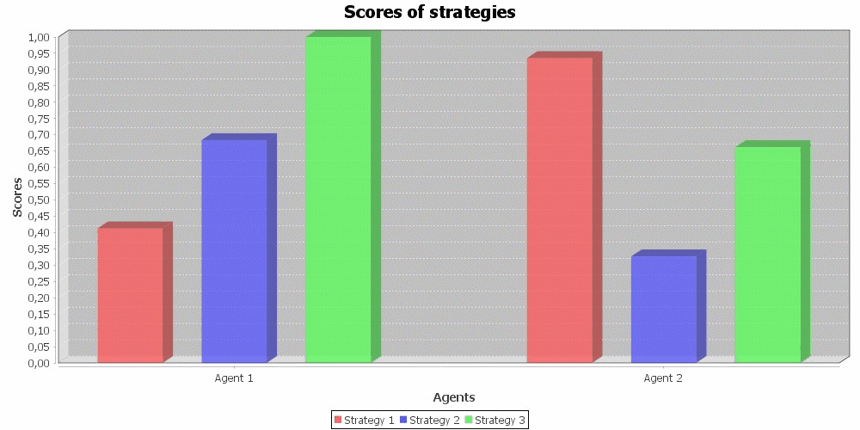
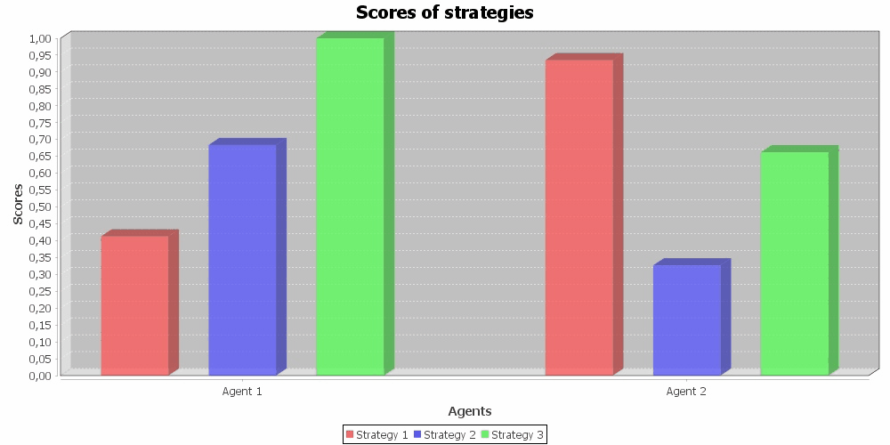
Negotiation Process - Example

Slide 13
Negotiation Process - Example
Runs the program: 50 times. In each run, two agents are selected randomly but in the given boundaries.
Negotiation: usually 20 times (depending on the threshold for agreement).
In each run, the input is slightly different (indicates the random choices).

Slide 14
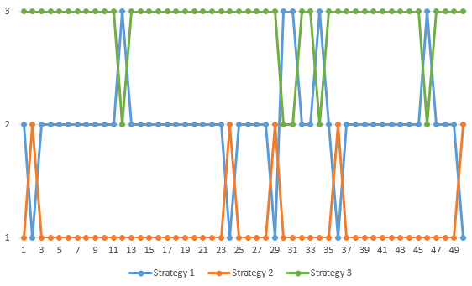
Conclusion
  Strategy 3 is the best solution in 45 runs.
  Strategy 1 is ranked as the second good solution in 41 runs.
  Strategy 2 is the worst solution in 45 runs.

Slide 15
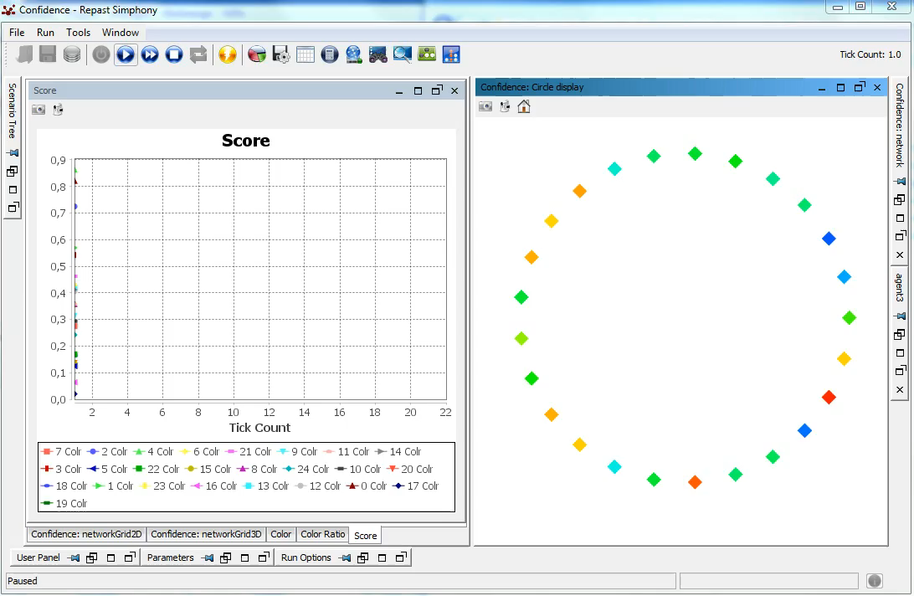
Use Case – Confidence Project

Slide 16
Future Work
Questionnaire-based modeling for agents.
Possible developments for negotiation simulation:
  Multi-layer, network, multi-threading...
  Fuzzy, bayesian, nonlinear...
Update knowledge database.

Slide 17
Thank you very much for your attention!
Questions?

