Slide 1
The basis for the Swedish emergency preparedness and response plan for ESS
5th NERIS Workshop, 3-5 April 2019
Anna Maria Blixt Buhr, Jan Johansson, Peder Kock, Jonas Boson, Simon Karlsson, Jonas Lindgren

Slide 2
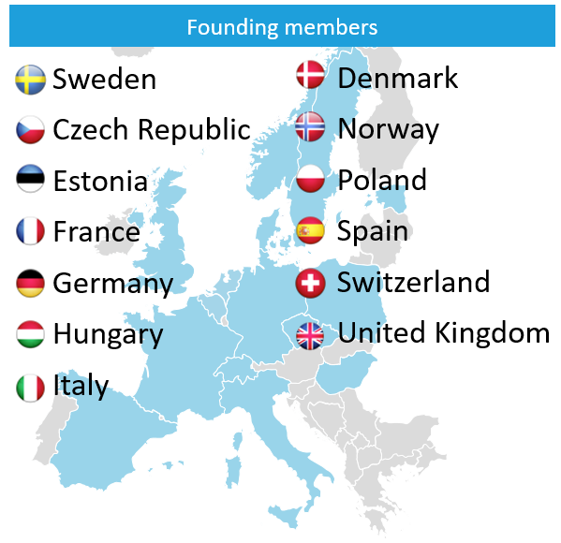
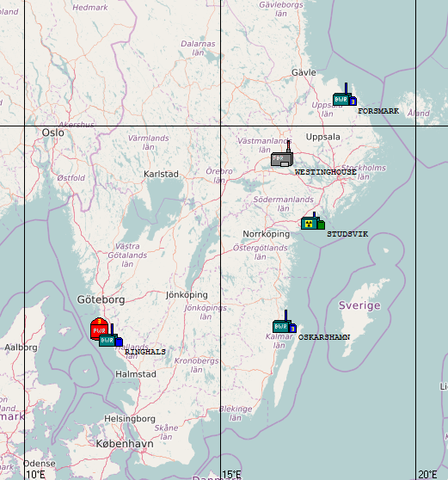
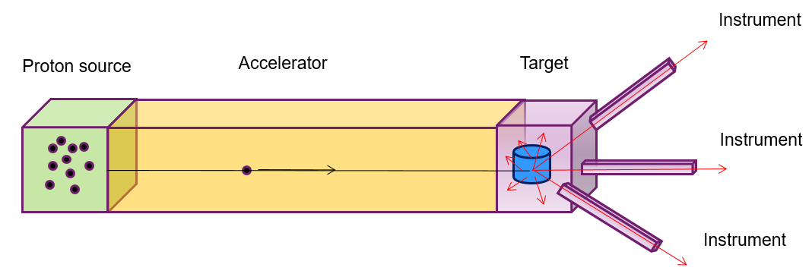
European
Spallation
Source
Illustration: ESS
Illustration: ESS

Slide 3
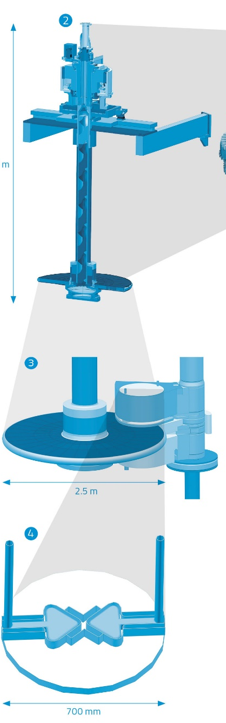
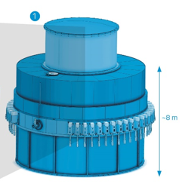
ESS - target
Target monolith
  - Beam windows
Rotating shaft
Target wheel
  - 7000 tungsten blocks
  - He gas cooling
Moderator-reflector plugs
  H₂0 and H₂
  Be and Pb
Illustration: ESS

Slide 4
Postulated event
Loss of target cooling while proton beam is in full operation (2 GeV, 5 MW)
The target has been in operation for 5 years
The target wheel is rotating
The vacuum in the accelerator area is maintained due to presence of proton beam window
”Unmitigated” case (no safety functions)

Slide 5
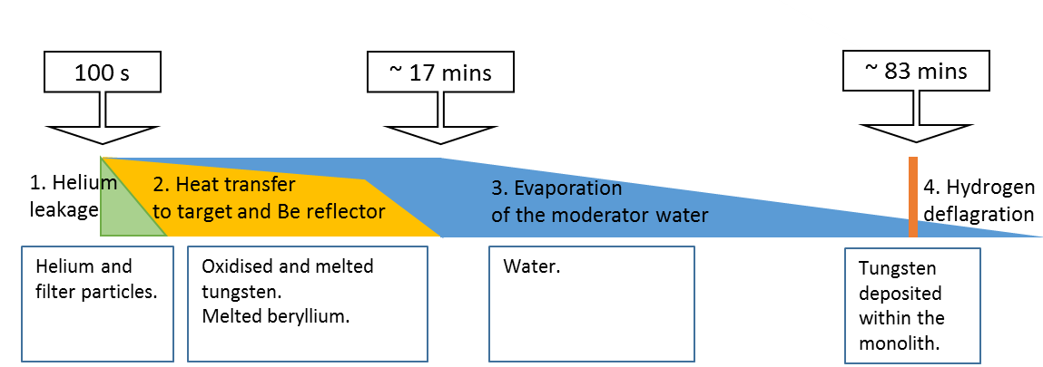
Summary of releases
4 release phases, duration:
  Helium leakage,10 s
  Heat transfer to target and Be reflector, 17 mins
  Evaporation, 167 mins
  Hydrogen deflagration, 10 s
Source term coming from different materials:
  He
  Filter particles in HEPA-filter in the He-cooling loop
  Tungsten target material (oxidised and melted)
  Be-reflector
  Water (moderator)

Slide 6
Representative source term
49 nuclides selected (~100% total dose) among 989 nuclides
1,3 PBq released activity from selected nuclides of total 1.7 PBq
Release height: 30 m (pressure release line)
Duration 6 hours in total in 4 phases
Not taken into account: thermal or mechanical lift

Slide 7



Effective dose (7 days) – exposure pathways
Cloud dose
Inhalation dose (committed)
Ground dose

Slide 8

ARGOS batch runs and post-processing
A release taking place every 26th hour during the period. Each release was modelled during a period comprising 72 hours.
The number of dispersion and dose calculations: 2750
Post-processing of results (greatest distance at which a dose criterion or an intervention level has been exceeded) into cumulative histograms (the percentage of weather scenarios encompassed as a function of distance).

Slide 9
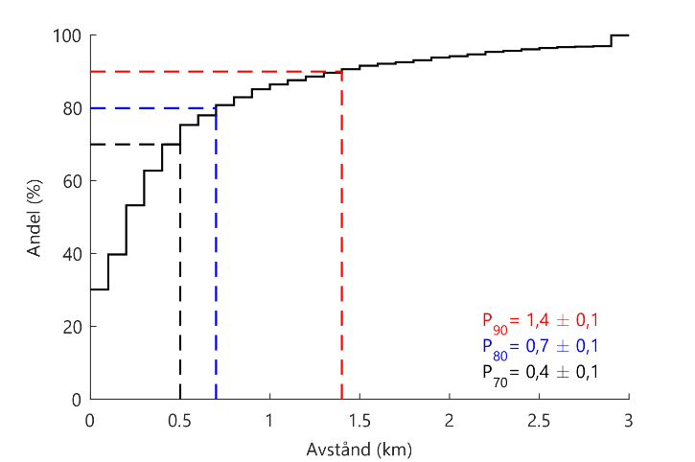
Results – protective actions
No need for the following protective action outside perimeter fence:
  Evacuation (precautionary evacuation, evacuation or relocation)
  Iodine thyroid blocking
Need for sheltering:
  outside perimeter fence
Adults is the limiting age group.

Slide 10
Conclusions
ESS is placed in Emergency preparedness category II (SSM decision taken in April 2018)
Lund Municipality should plan for an Urgent protective action planning zone, UPZ, of around 700 m from the release point. The final UPZ area should be designed in view of having an effective EPR planning.
No need for an emergency planning distance, EPD (no relocation plans due to ground deposition)
Performed sensitivity studies strengthens the need for UPZ conclusion

Slide 11

Thank you!
Report in Swedish:
google ”SSM 2018:22”
annamaria.blixtbuhr@ssm.se

